Slide 1
Introduction
April 2019
Guy Harrison
CTO ProvenDB

Slide 2
We’ve all heard about the blockchain
Blockchain has the potential to change the way we buy and sell, interact with government and verify the authenticity of everything from property titles to organic vegetables.
– Goldman Sachs (https://bit.ly/2Lpctck)
The blockchain is an incorruptible digital ledger of economic transactions that can be programmed to record not just financial transactions but virtually everything of value.
Hailed as a one of the biggest paradigm shifts since the internet itself
An economic/transactional layer integrated directly into the internet without the need for centralized control
Blockchain market estimated to add $176 billion business value over next 7 years.
Potentially disruptive to multiple industries and technology segments.
Including the database market….
– Don & Alex Tapscott, authors Blockchain Revolution (2016)
The business value-add of blockchain will grow to slightly more than $176 billion by 2025, and then it will exceed $3.1 trillion by 2030.
– Gartner (G00325744)
[blockchain] is revolutionary and has the potential to revolutionize nearly every industry.
– Forbes (https://bit.ly/2Oc23C5)
The overall market for database management solutions, [is] valued by IDC to be over $50 billion by 2018.
– Forbes (https://bit.ly/2Q5OJMY)

Slide 3
Blockchain vs DBMS
The Blockchain represents a new type of database:
Public
Tamper Proof
Distributed
Immutable History
Transactions on the Blockchain are public (though they may be anonymous).
Transactions on the Blockchain cannot be altered and are cryptographically proven.
The Blockchain has no central administrator or centralized data storage
The full history of all Blockchain transactions is preserved.

Slide 4
Immutability is Revolutionary
Trust is a foundational feature of the blockchain as the data written into it is immutable, and can never be changed, modified or removed.
They say history is written by the winners.
In databases, history is written by the developer or the DBA.
There’s no practical way to detect back-dating or tampering with historical data.
But there’s no arguing with blockchain data.
Once sealed on the blockchain, historical data is immune from modification.
– Wall Street Journal (https://on.wsj.com/2PJ1Wem)

Slide 5
Legal recognition is emerging….
A signature that is secured through blockchain technology is considered to be in an electronic form and to be an electronic signature.
- Arizona Bill HB2603 https://www.azleg.gov/ars/44/07061.htm
A digital record electronically registered in a blockchain shall be self-authenticating pursuant to Vermont Rule of Evidence 902.
- 2016 Vermont StatutesTitle 12 https://bit.ly/2OFHNtS
the usage of a third-party blockchain platform that is reliable without conflict of interests provides the legal ground for proving the intellectual infringement.
- Hangzhou Internet Court (China) https://bit.ly/2R8dw3H
Blockchain legislation pending or passed in at least 18 US states https://bit.ly/2L4Oksc

Slide 6
Blockchain vs DBMS
Compared to a traditional DBMS, the blockchain has many drawbacks:
Performance
Capacity
Structure
High Latency, low throughput
Minimal data storage capacity
No Schema or data model
Privacy
Productivity
Cost
APIs are complex and unfamiliar
Transactions are publicly visible
Each transaction has a significant cryptocurrency cost

Slide 7
The economics are ruinous

Slide 8
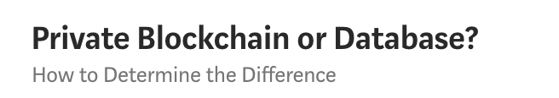
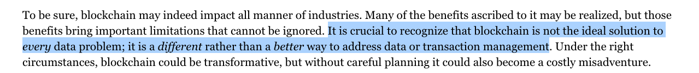
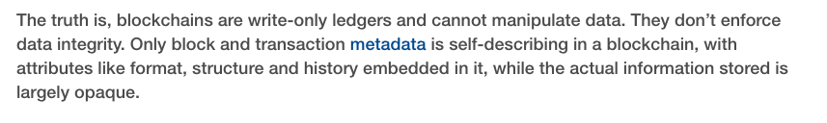
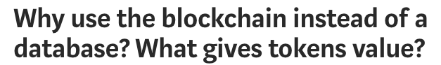
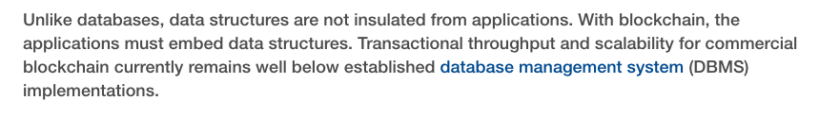
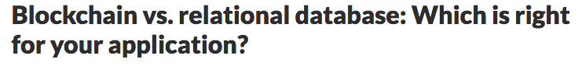
This is the dilemma:
Use a database and sacrifice immutability and tamper detection
OR
Use the blockchain and sacrifice performance and economics

Slide 9
ProvenDB bridges the gap
A fully functional database service:
Blockchain integration:
MongoDB storage layer
Versioning of data
Point in time history
Normal throughput and latency
Immutability
Complete data provenance
Rich query and database operations
Tamper detection
Strong privacy

Slide 10
How is ProvenDB different?
Versioning of data
Tamper detection
Complete data provenance
New data doesn’t over write old data – instead a new version of data is created.
Any attempt to tamper with database records can be detected by blockchain technology
View the complete history of changes to any data item.
Immutability
Point in time history
Selected versions of data are “pinned” to the blockchain and cannot be altered.
The state of the database at previous points in time is always available.

Slide 11


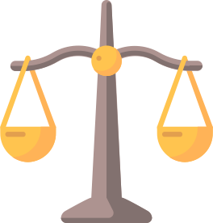

When would you use it?
To prove you created some content – intellectual property for instance.
To prove that a document or data has not been tampered with or altered.
To prove the date of a legal or official document.
To prove the exact history (provenance) of some data.

Slide 12
Applications that would benefit from ProvenDB
Document Management Systems
Legal Record Keeping
Intellectual property solutions (data rooms, media management)
Audit and and access management systems
Accounting
Government and regulatory

Slide 13
How does it work?

Slide 14
A hash is a mathematical "signature” of a document – a digital finger print
The chances of two documents having the same hash are infinitesimally small –
Even if every computer in the world today generated hashes as fast as it could, it would still take many times longer than the lifetime of the universe to find a duplicate
In practice, hashes are far more precise proofs of identity than DNA or fingerprints.
Hash Signatures
Document
Hash

Slide 15
Blockchain basics
2.
Calculating the block hash is computationally expensive. First node on the blockchain network to correctly calculate the hash is rewarded with bitcoins.
Blockchain
Block
Block
Block
Block
1,048,576
1,048,577
1,048,578
1,048,579
3.
Proof of Work
Proof of Work
Proof of Work
Proof of Work
Changing a transaction on the blockchain requires rebuilding the block and all subsequent blocks faster than the all of the current nodes on the blockchain network.
This becomes effectively impossible the deeper the block is on the chain. Once data is embedded in the blockchain, it requires an impossibly large amount of computing power to change it.
000000rejf67
000000ueri32
0000007uy654
00000078ujma
Previous Block
Previous Block
Previous Block
Previous Block
000000erw562
000000rejf67
000000ueri32
0000007uy654
Transaction IDs
Transaction IDs
Transaction IDs
Transaction IDs
743ojd 8932ue iuy76
Io8548 9765mp twej45
mj721t ijdy73 mp06gv
jiu6ub 2xc432 09okju
1.
Each block on the blockchain contains a hash of all transactions and a hash of the previous block's hash.

Slide 16
Blockchain proofs
Hash
Document
X
1.
The simplest way to perform proof of existence is to hash the document and push that hash to the blockchain.
Once the hash is embedded in the blockchain, it can be used to prove that the document:
Existed on that date
Has not been tampered with
Was created by a specific individual
Block
Block
Block
1,048,577
1,048,578
1,048,579
Proof of Work
Proof of Work
Proof of Work
000000rejf67
000000ueri32
0000007uy654
2.
There are two problems with this approach:
Each document requires it’s own blockchain transaction - expensive and environmentally irresponsible.
The document can be lost or altered in which case the proof is useless.
Previous Block
Previous Block
Previous Block
000000erw562
000000rejf67
000000ueri32
Transaction IDs
Transaction IDs
Transaction IDs
743ojd 8932ue iuy76
Io8548 9765mp twej45
mj721t ijdy73 mp06gv
Blockchain

Slide 17
Aggregating hashes using Merkle trees
2.
We don’t need the whole tree to prove an individual document is included in the final hash - we just need the “merkle path”.
Hash all documents
Build binary tree of hashed hashes
1.
We can prove multiple documents with a single hash using a “merkle tree”.
Place final “root” hash on BlockChain
3.
Thousands of documents can be included in a single merkle tree - all anchored to a single blockchain transaction.

Slide 18
A persistent versioned datastore
1.
Transactions to ProvenDB are stored (append-only) in the MongoDB database and hashes of the transactions posted to the Blockchain.
Database User
MongoDB
ProvenDB
2.
Each transaction creates a new version within the database. The database user or application can explore older versions and their proofs at any time.
3.
The database user requests a proof be placed on the blockchain for a specific version. This version can be used to prove the timestamp of the entire version or any document in that version.

Slide 19
Features at a glance
Document Model
Fast Bulk Load
Export
Data is stored in MongoDB document format (JSON/BSON).
Bulk loader allows mass data to be loaded into a single version.
Data can be exported to a provable archive completely independent of the ProvenDB system.
Strict Consistency
Full Database Proofs
Compaction
New versions of data are deterministic and serializably consistent.
The entire state of the database can be established with a single blockchain proof.
Intermediate data between two proofs can be deleted, saving storage without compromising blockchain proofs.
Right to be Forgotten
Single Document Proofs
Data can be redacted without destroying database proofs. GDPR compliant.
Any document in the database can be validated against a blockchain proof.

Slide 20
Demo

Slide 21
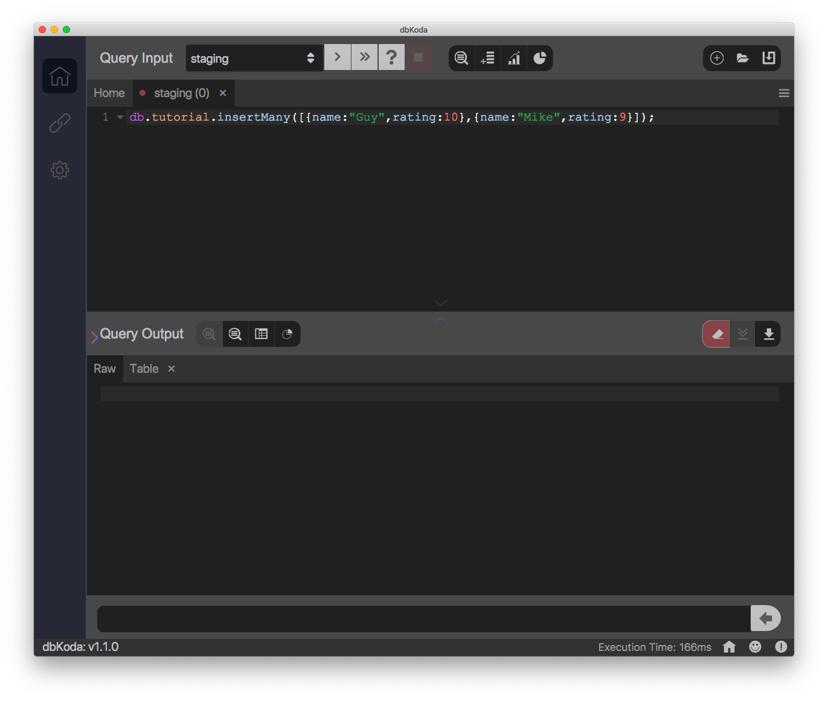
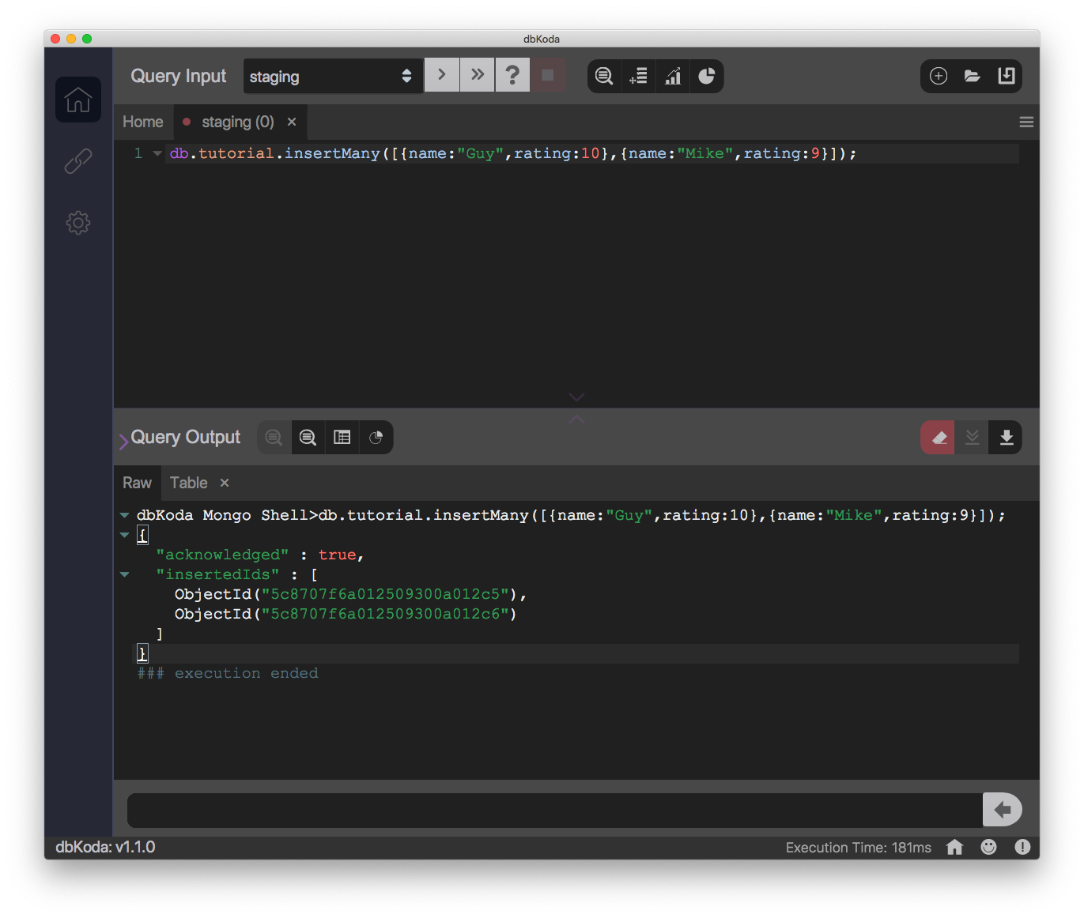
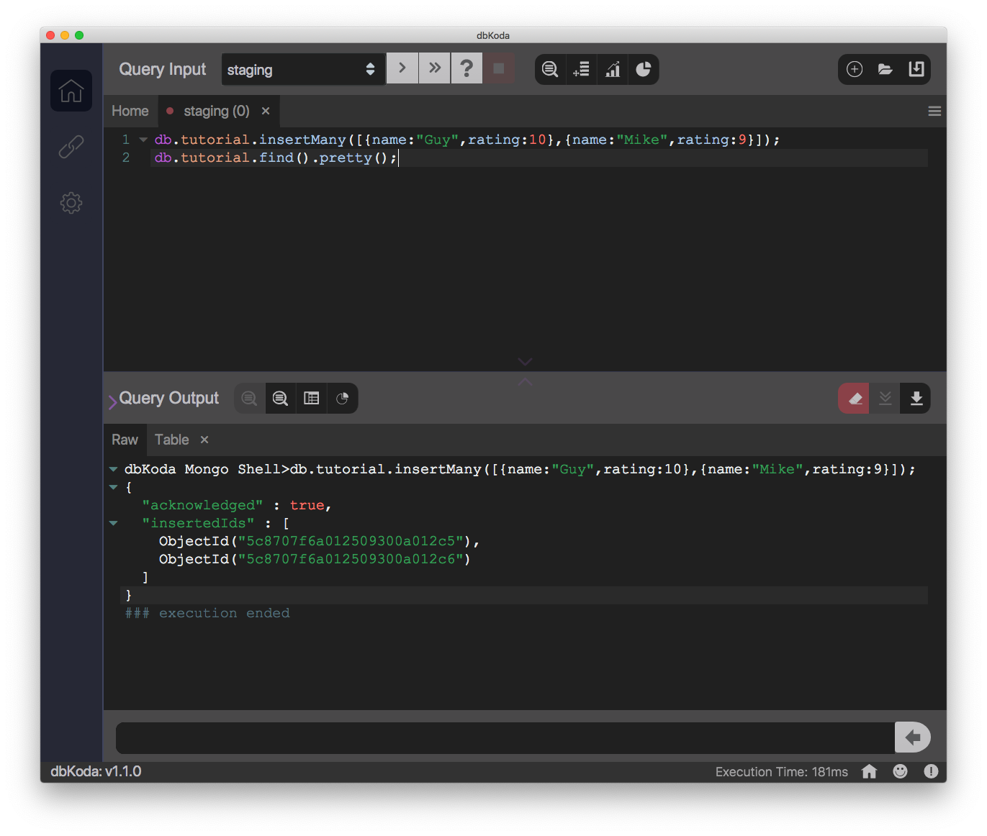
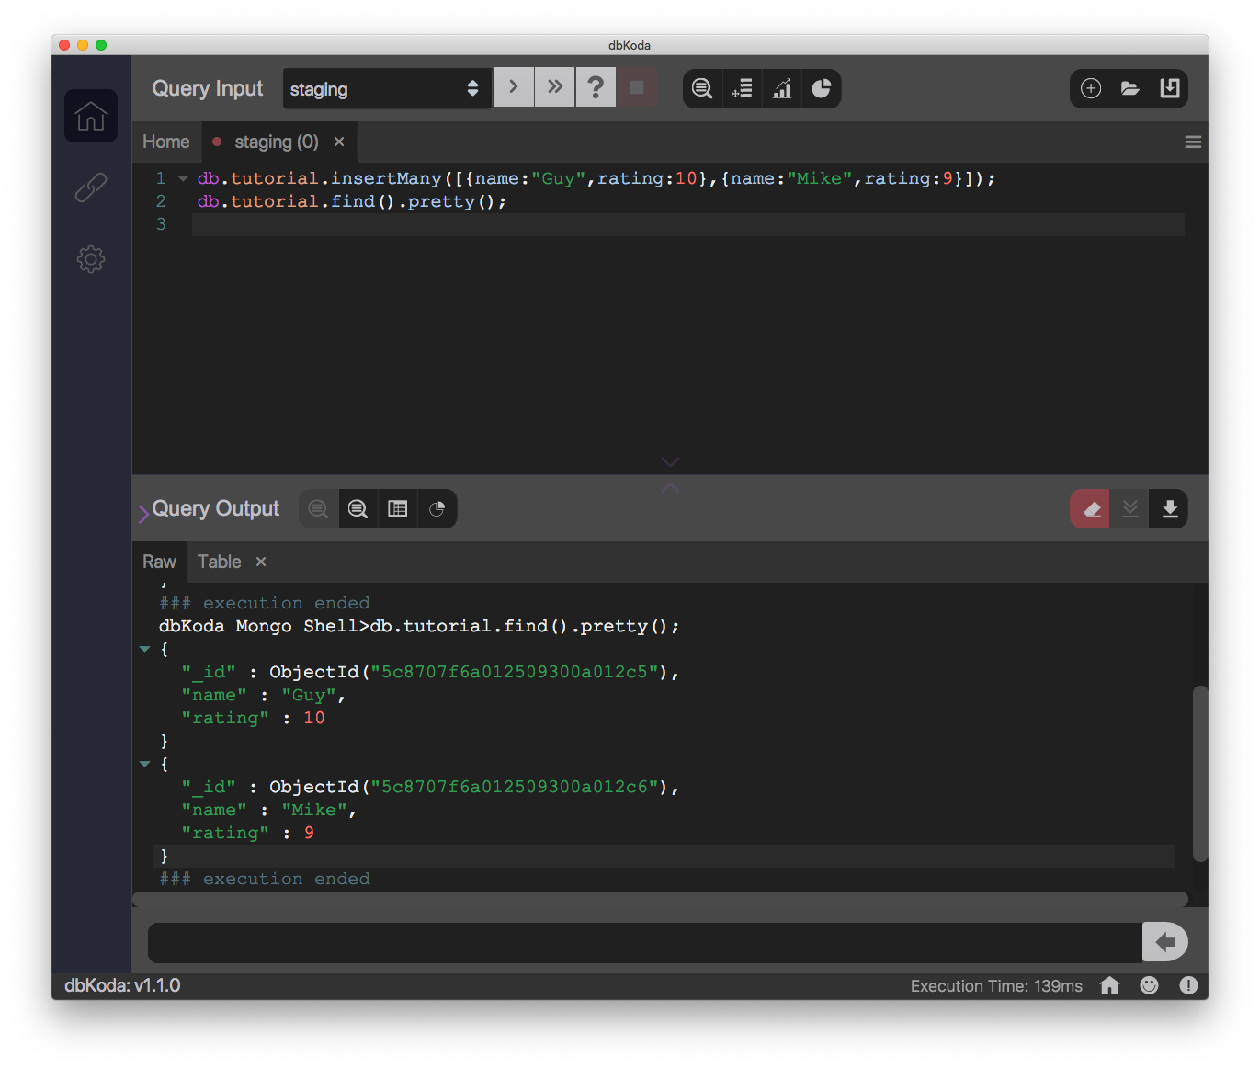

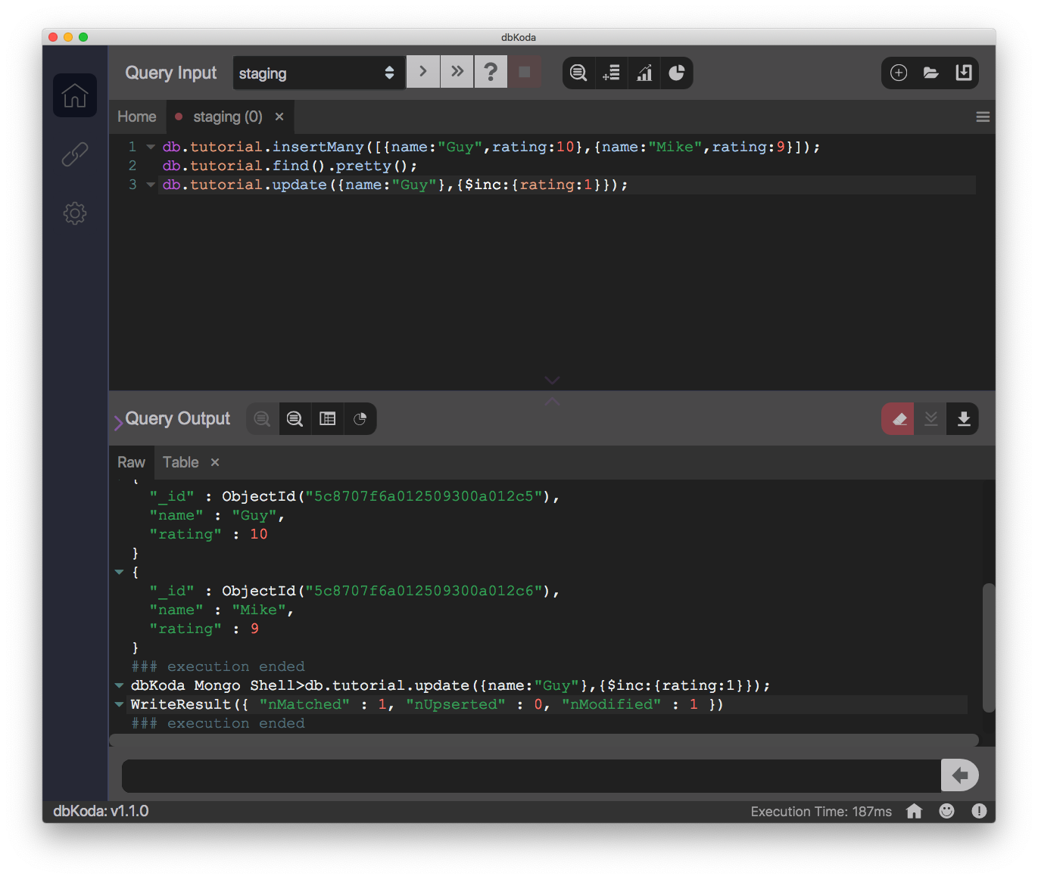

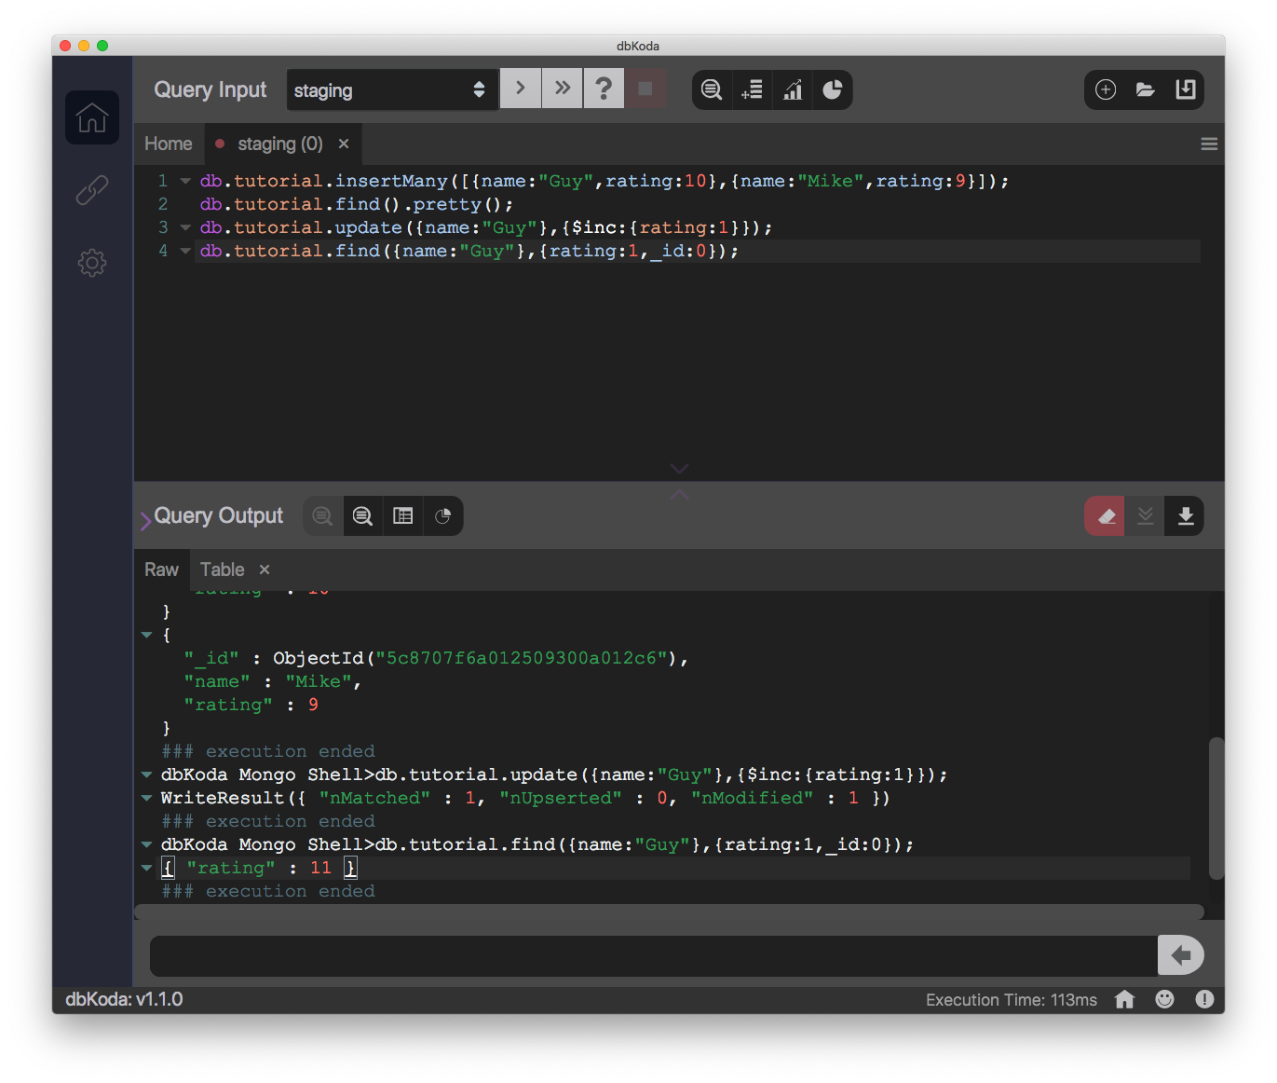
MongoDB compatible
ProvenDB uses MongoDB for data storage and accepts standard MongoDB commands for inserting, updating and retrieving data

Slide 22
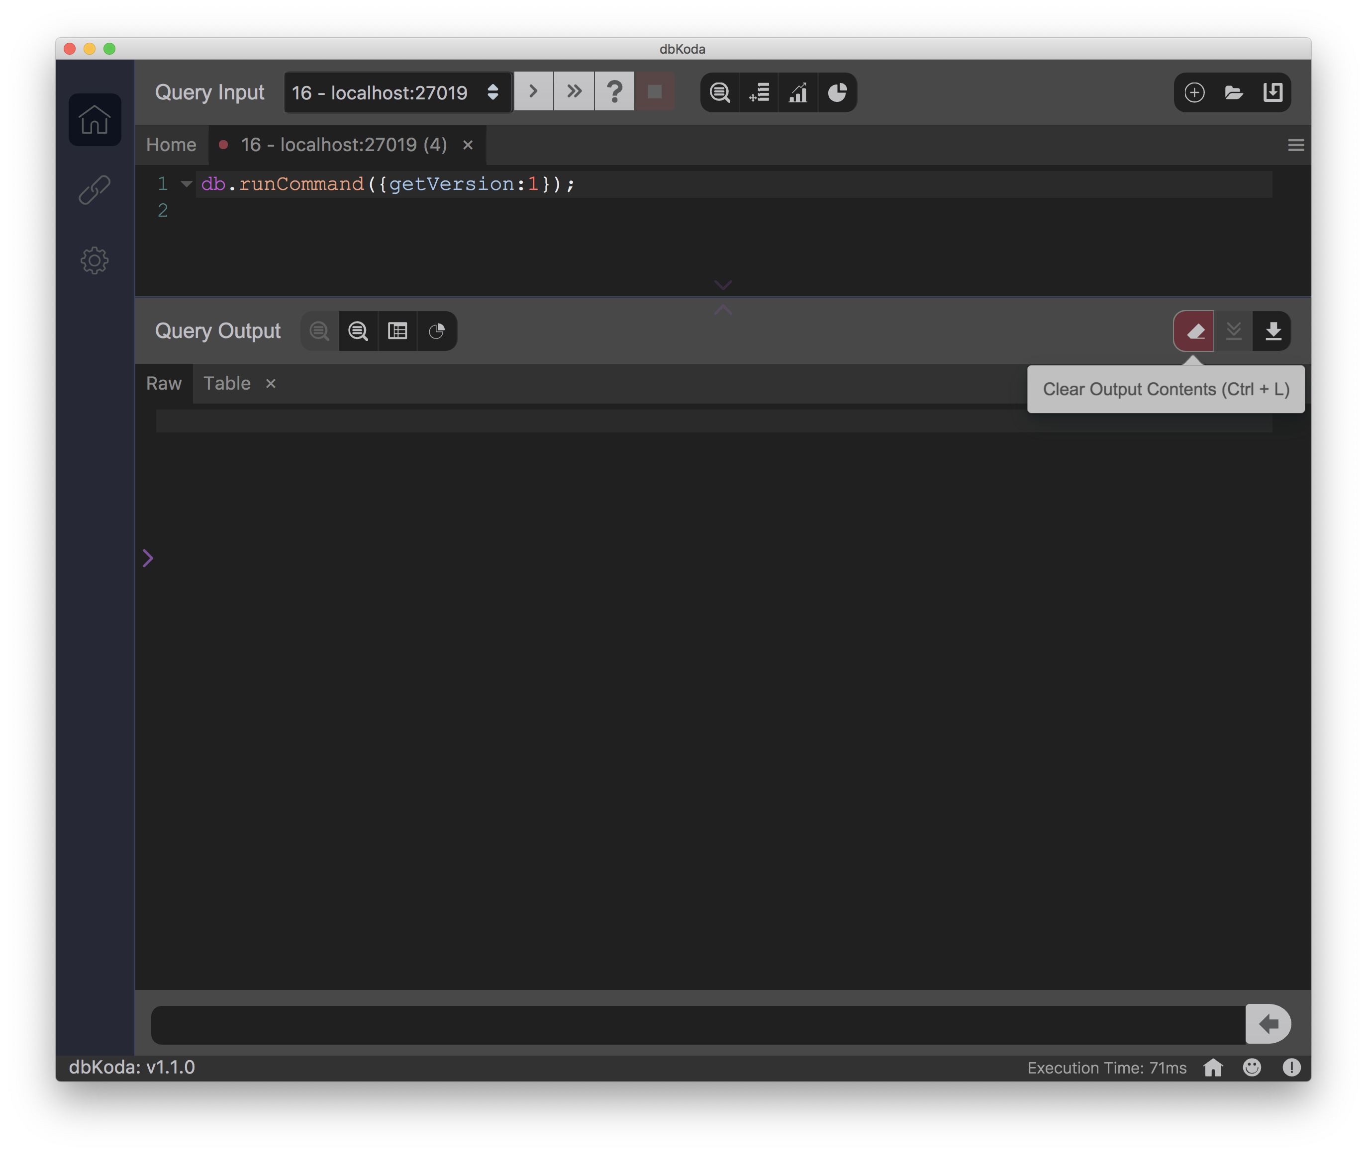
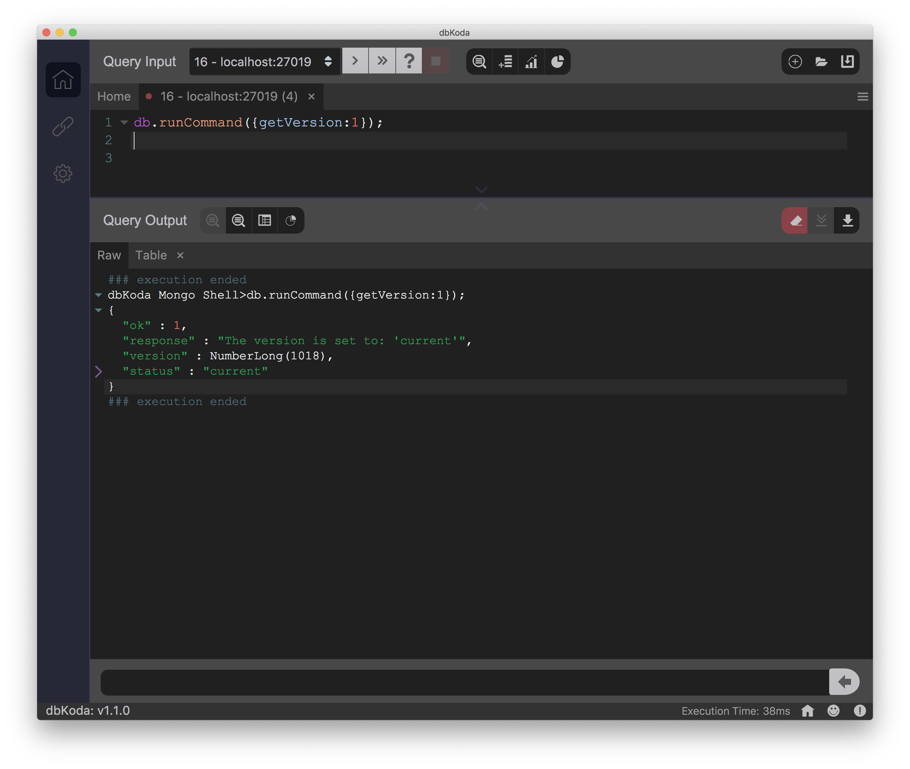
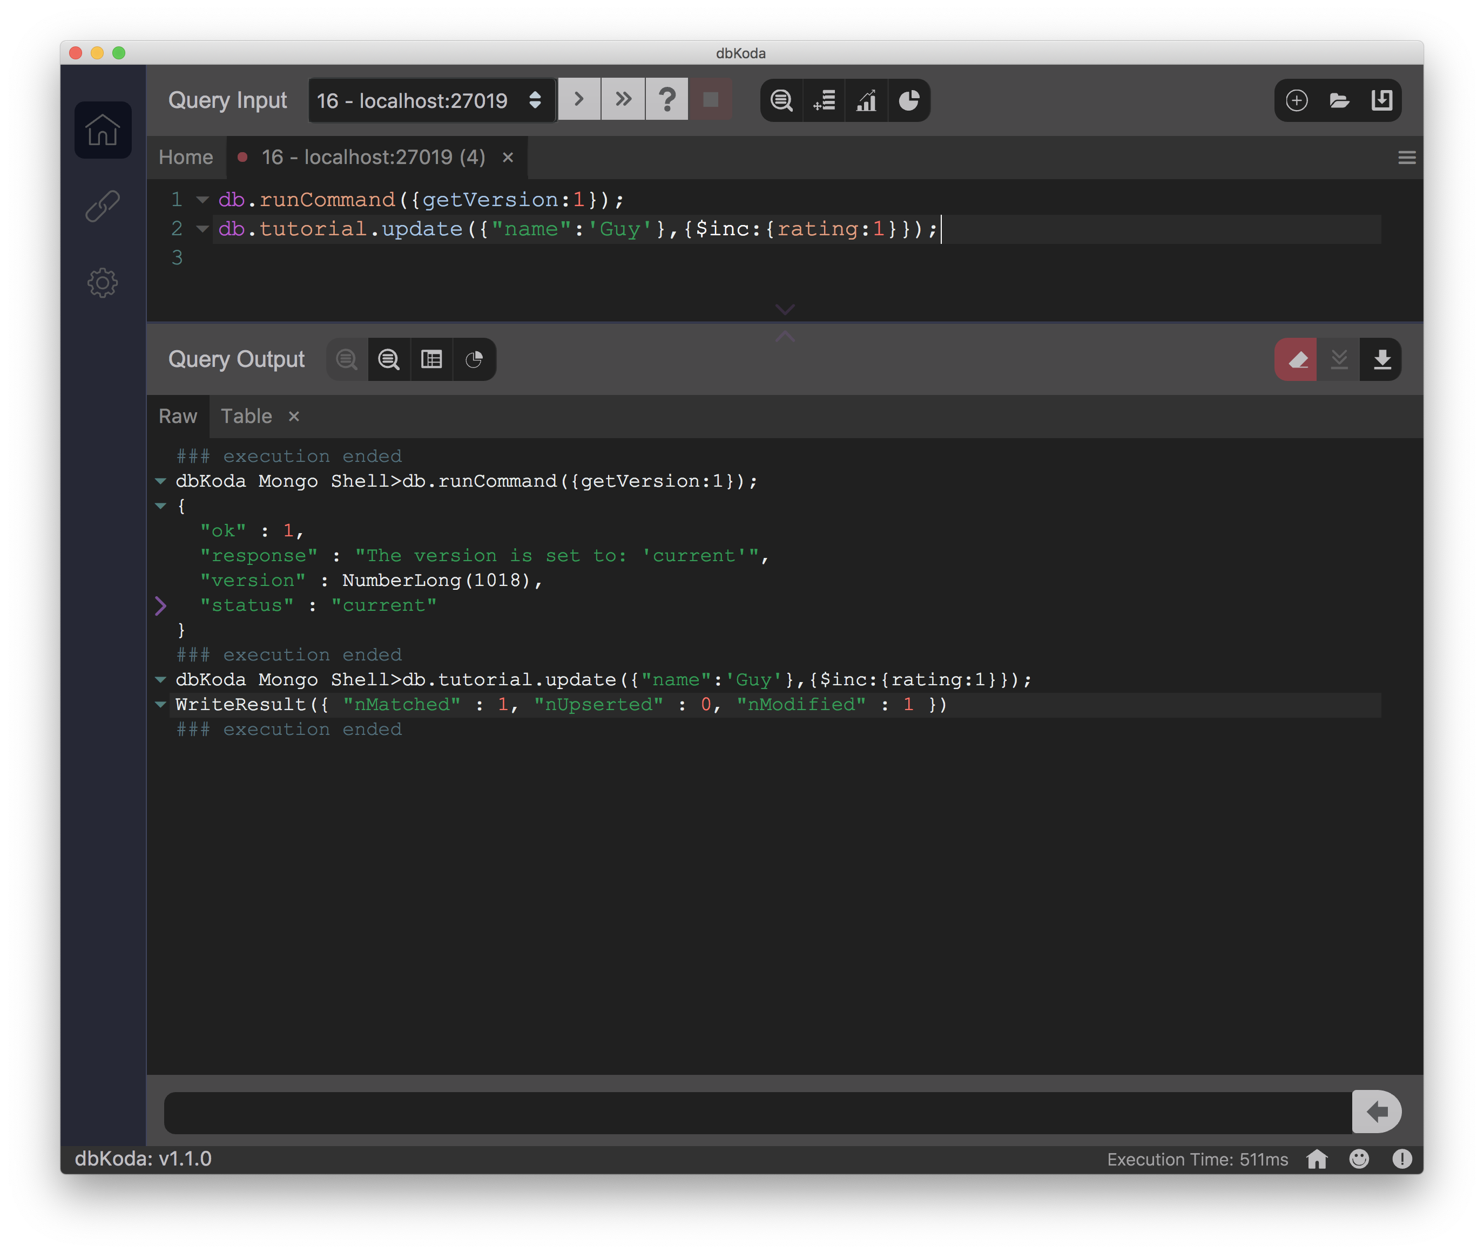
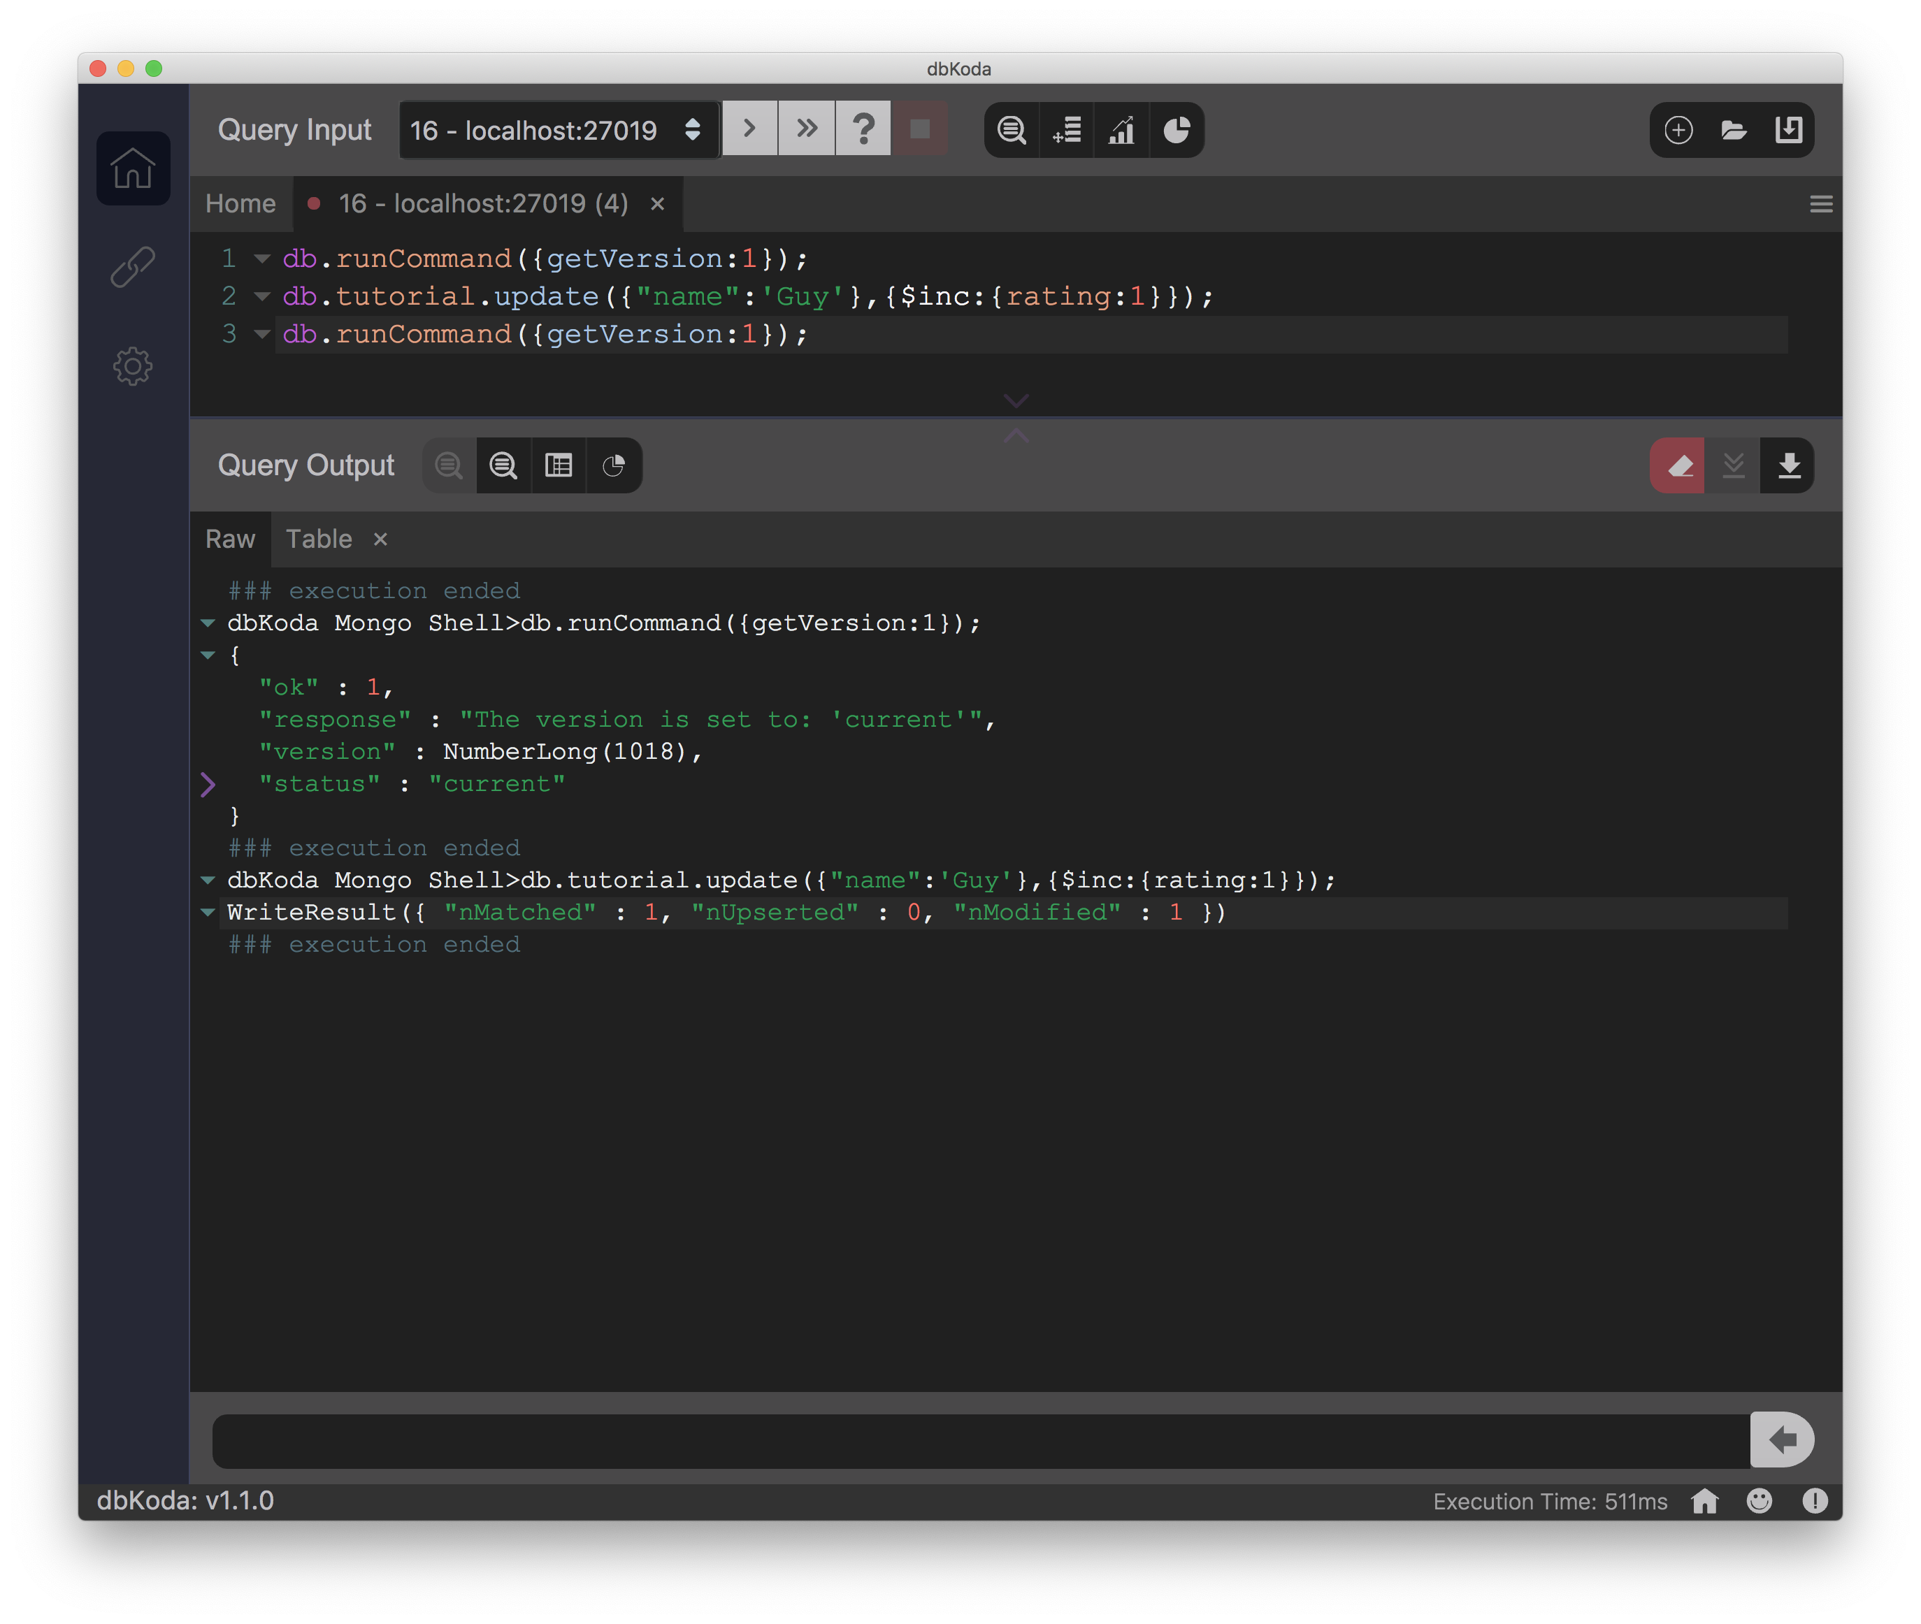
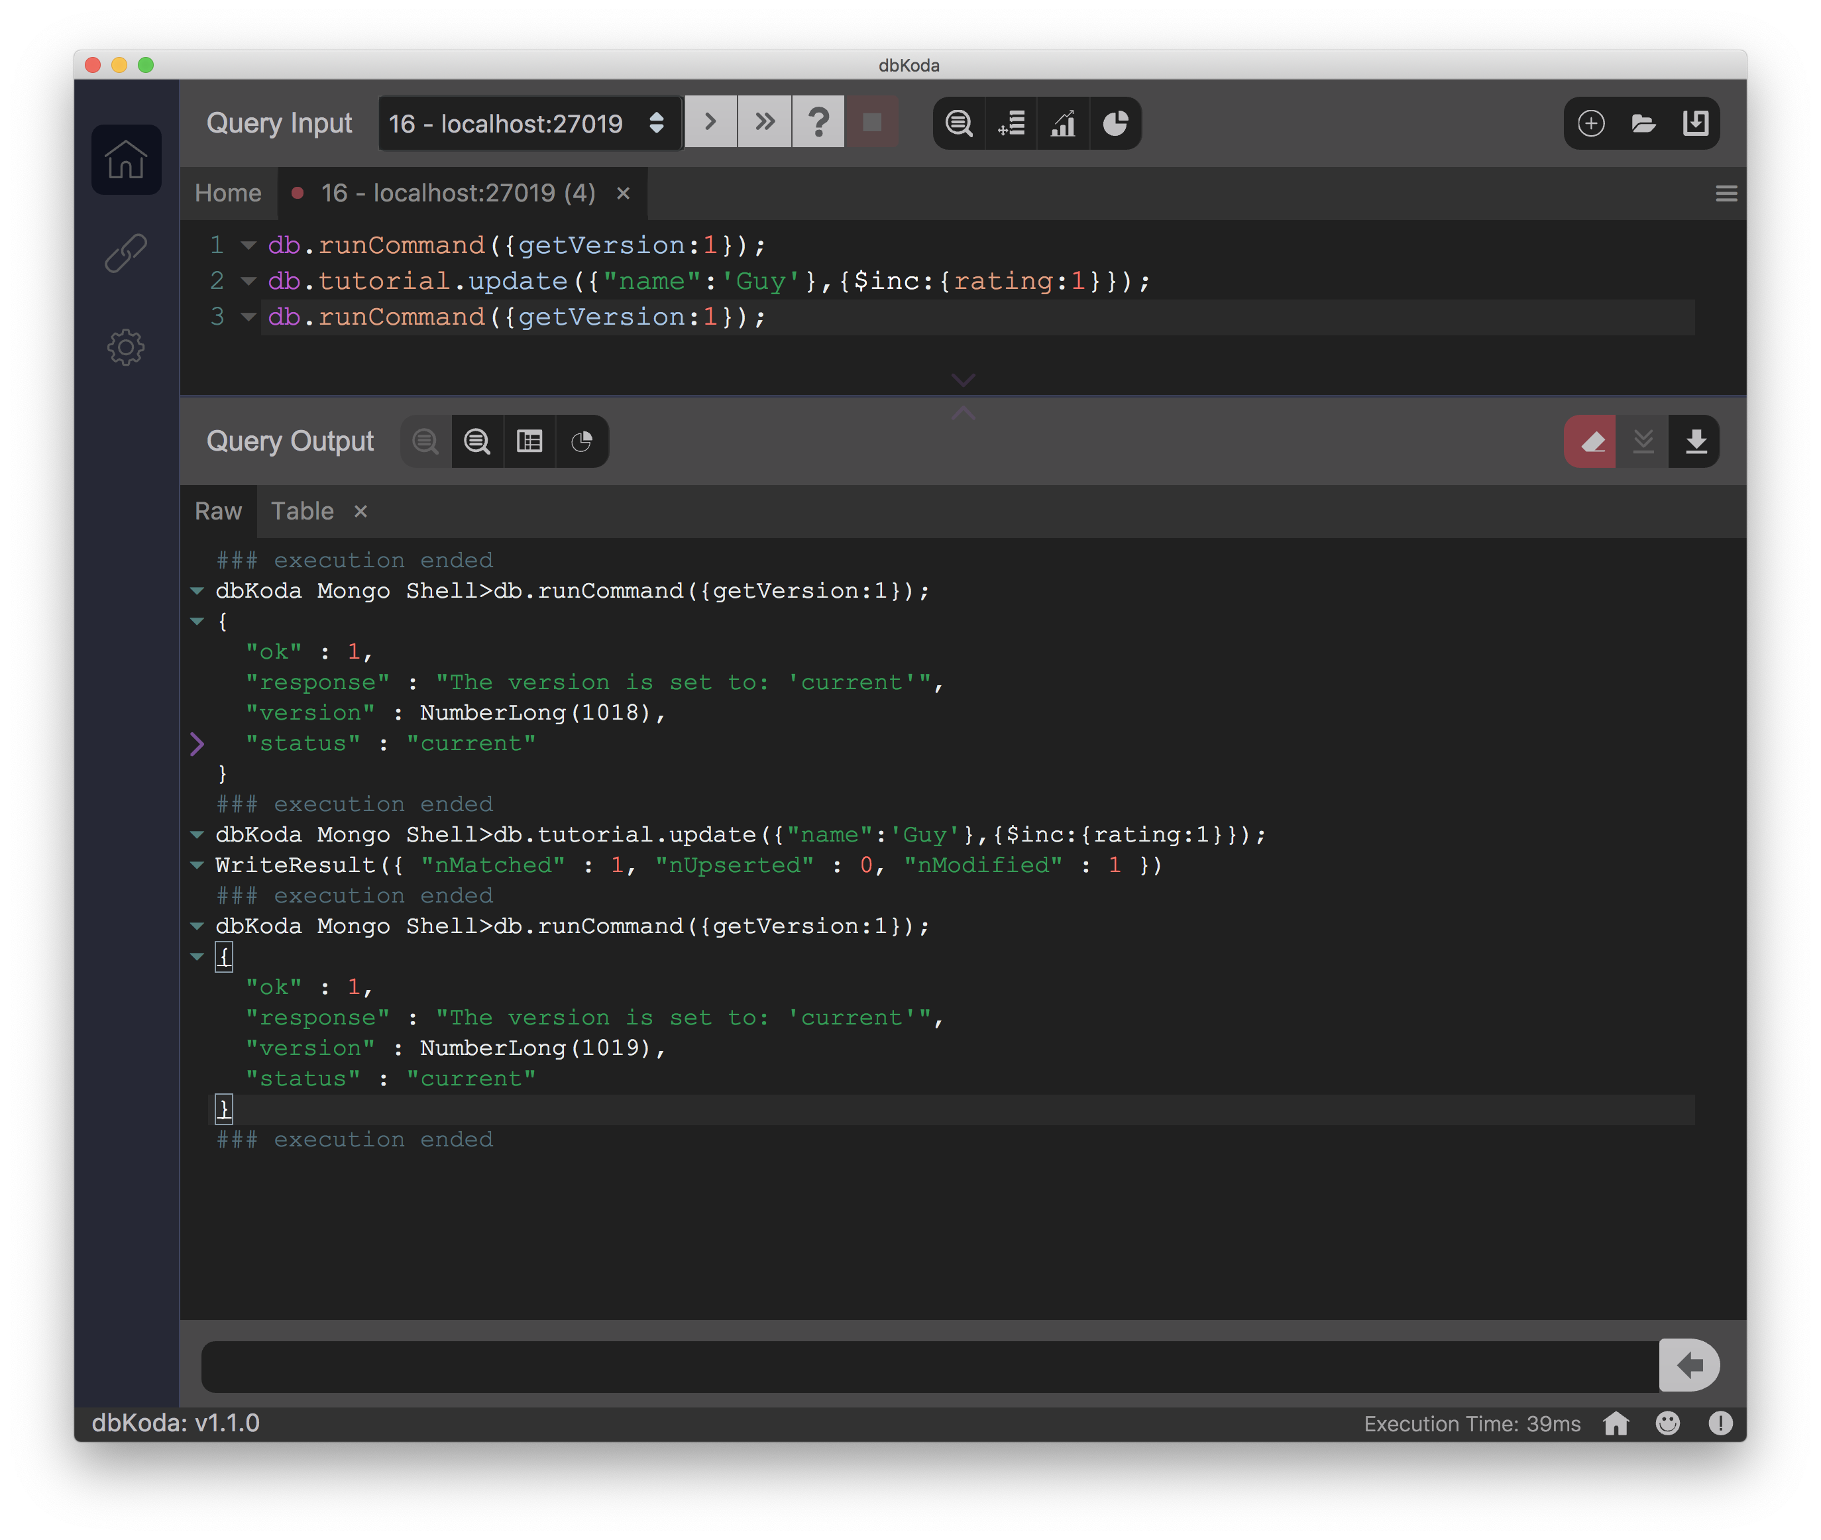
Versions
Unlike regular MongoDB, ProvenDB maintains multiple versions of your documents
The getVersion command reveals the current version number
The number increments after every update

Slide 23
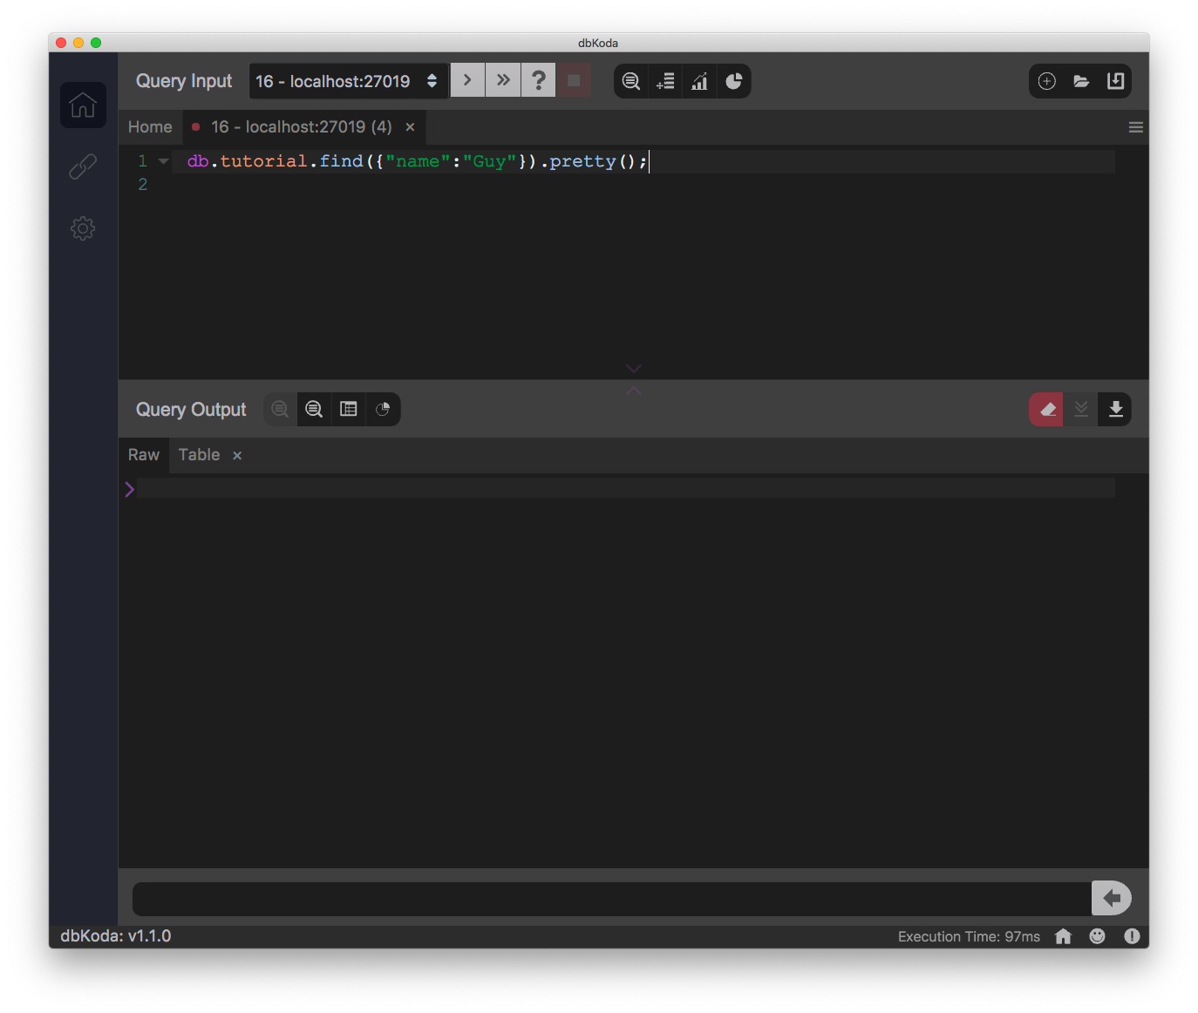
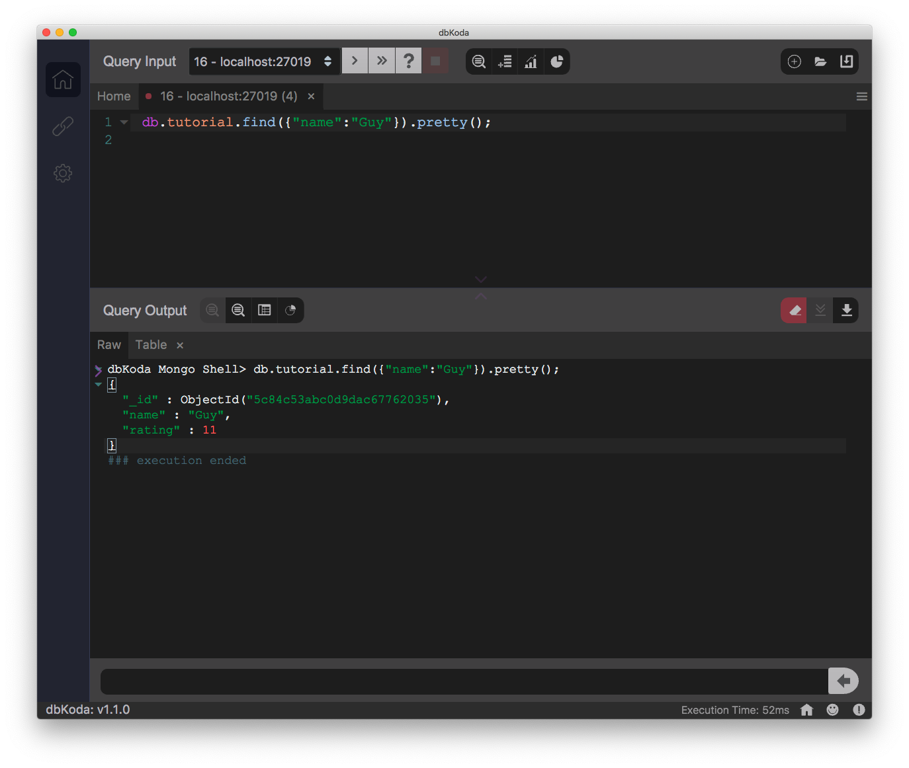
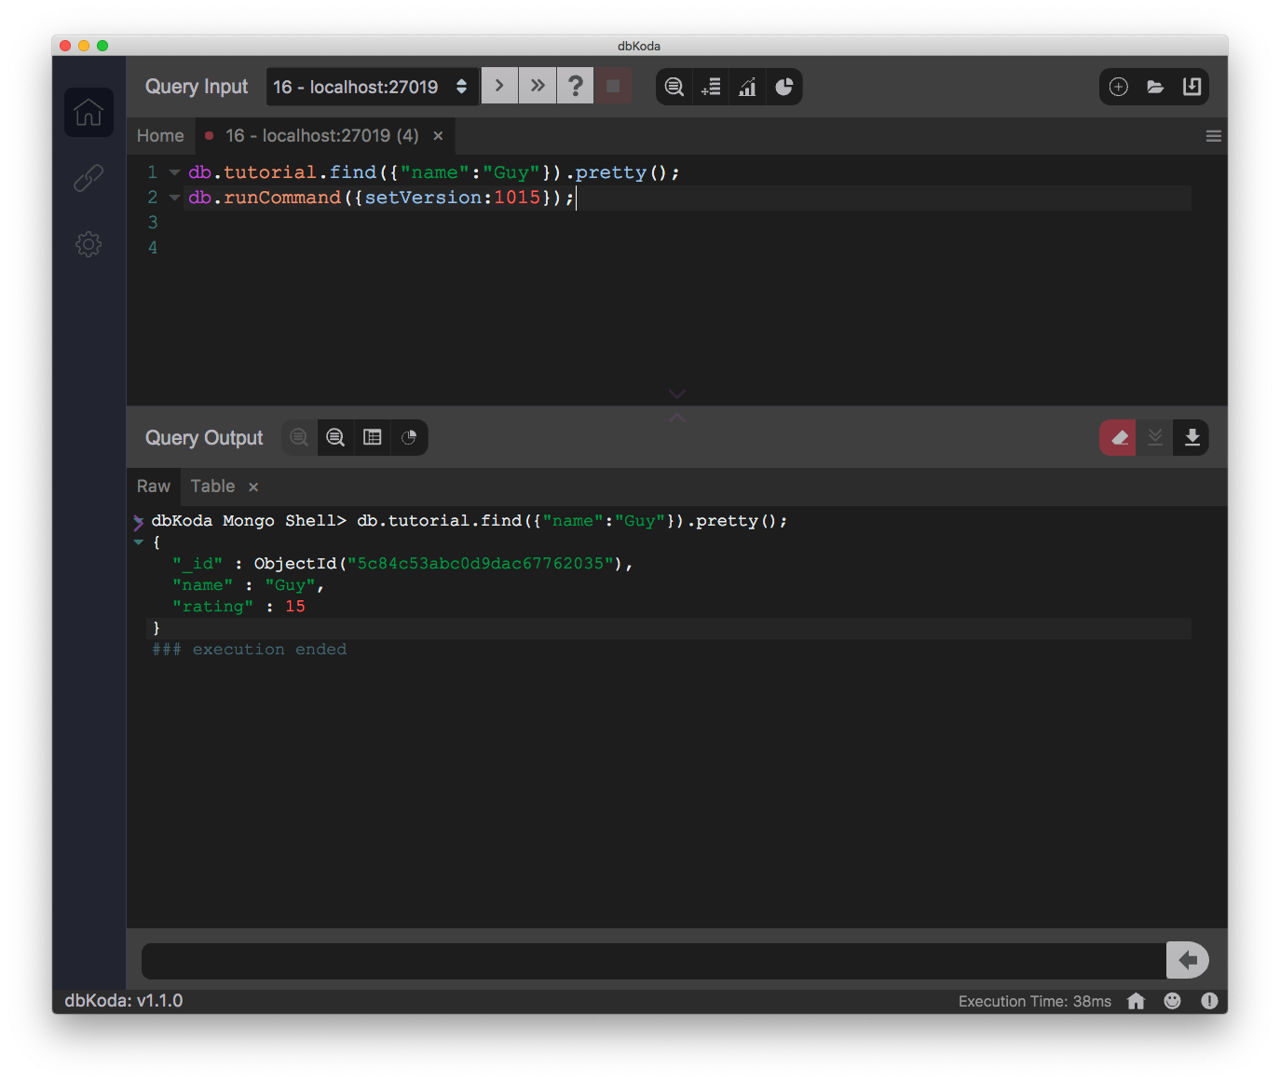
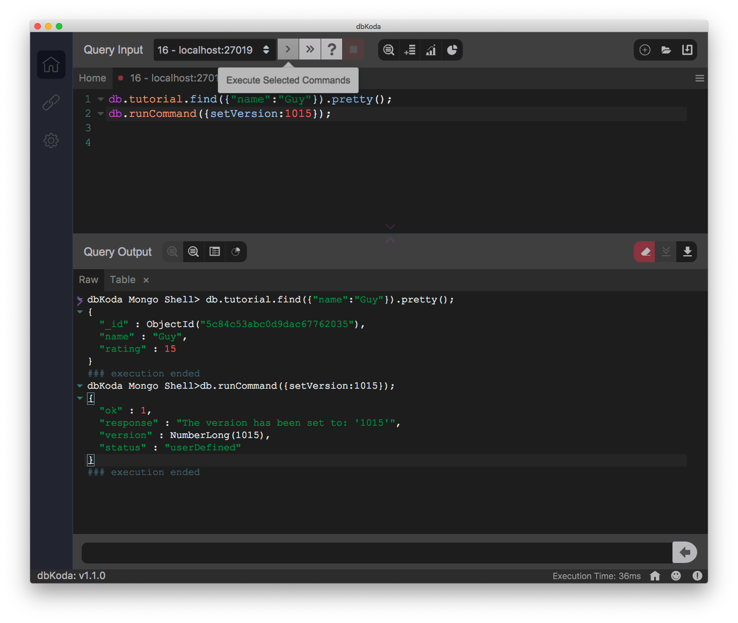
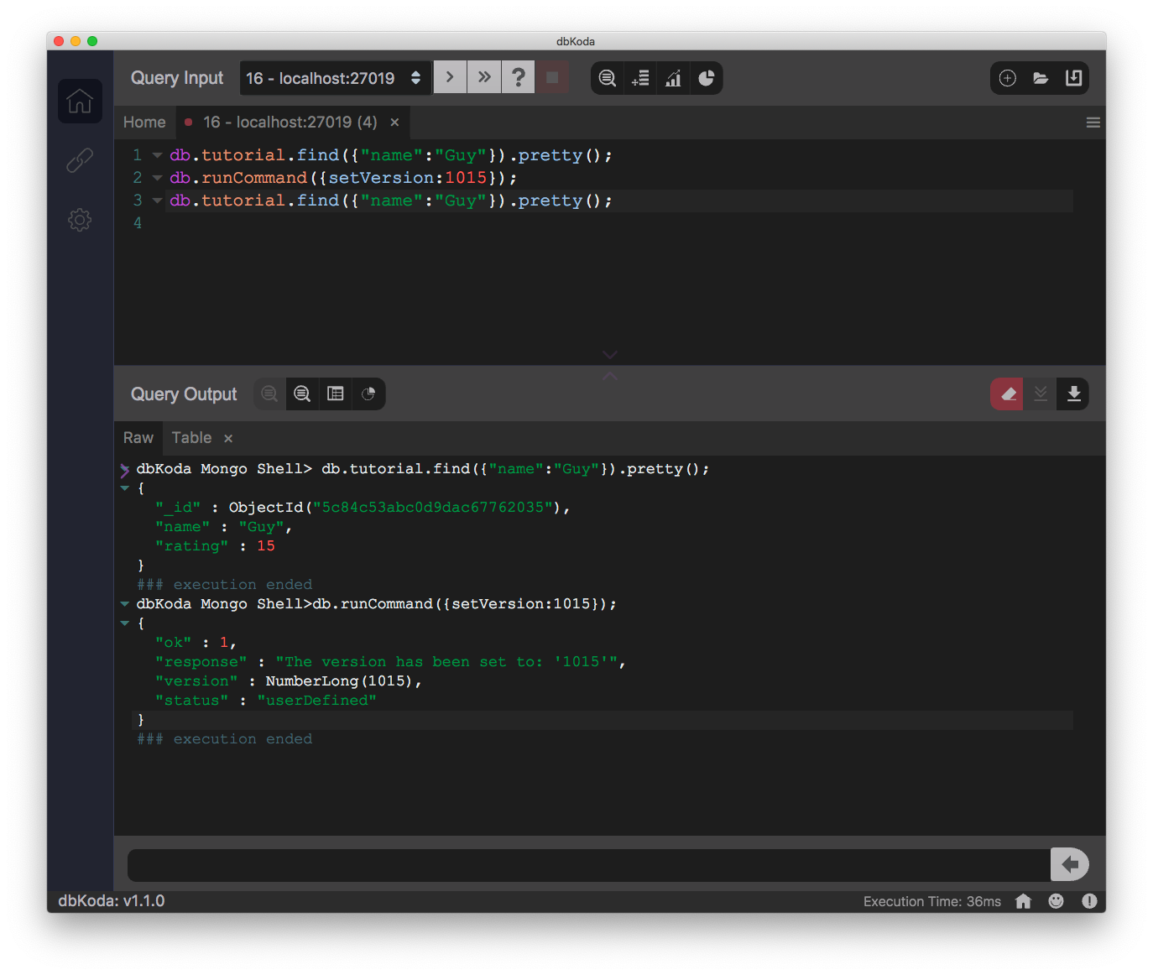
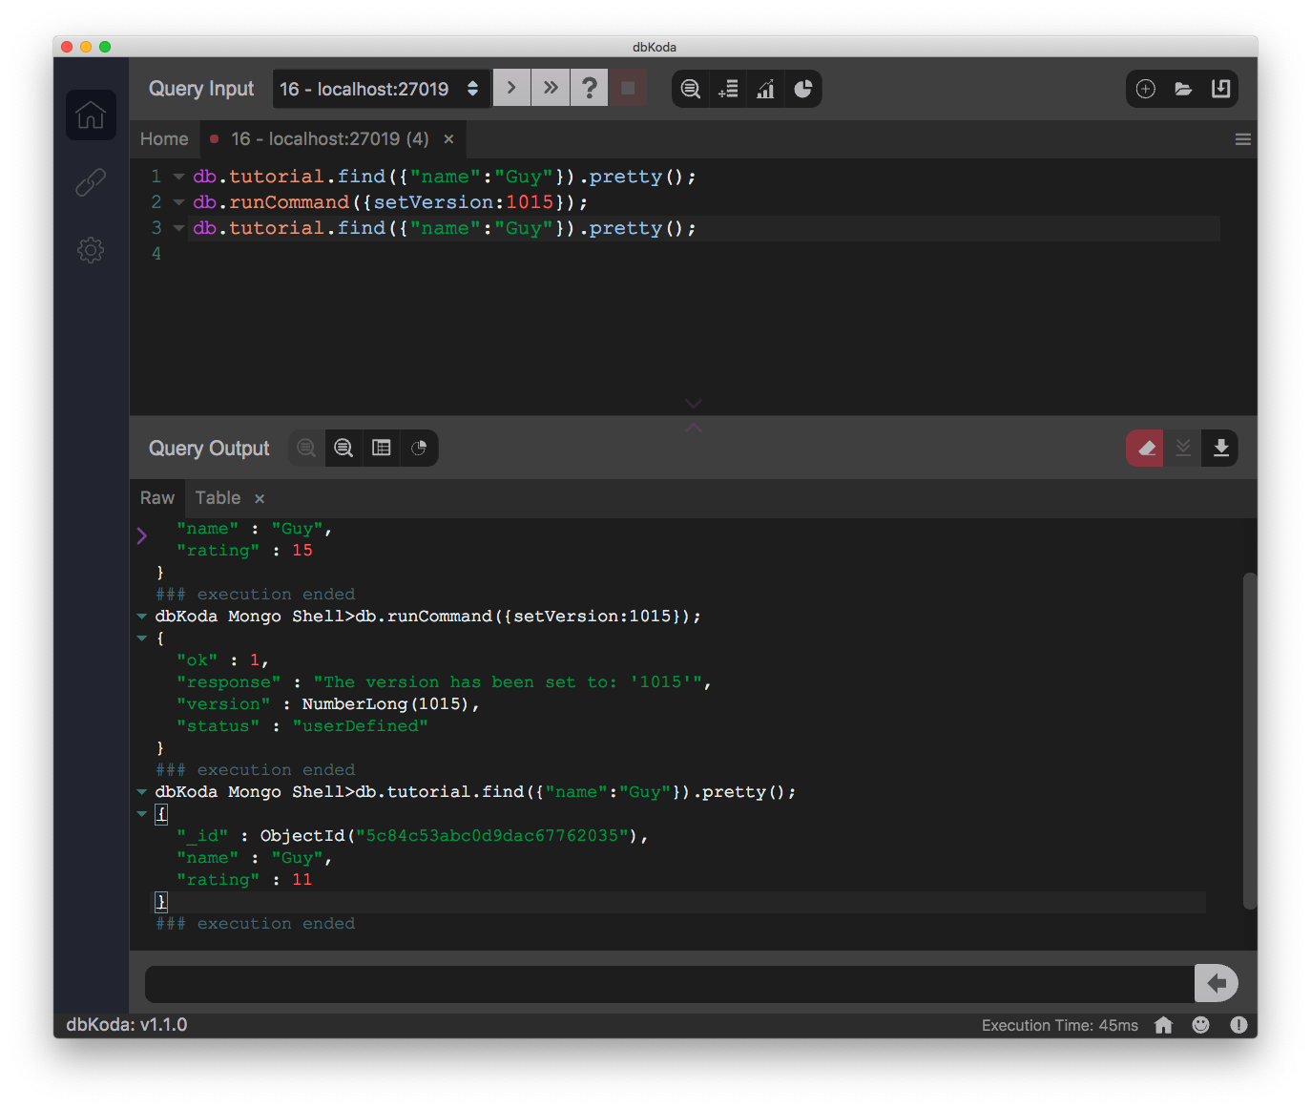
Versions
setVersion allows you to set the active version
You will then see the state of documents at that version
You can “time travel”, but you can only modify documents in the current version

Slide 24
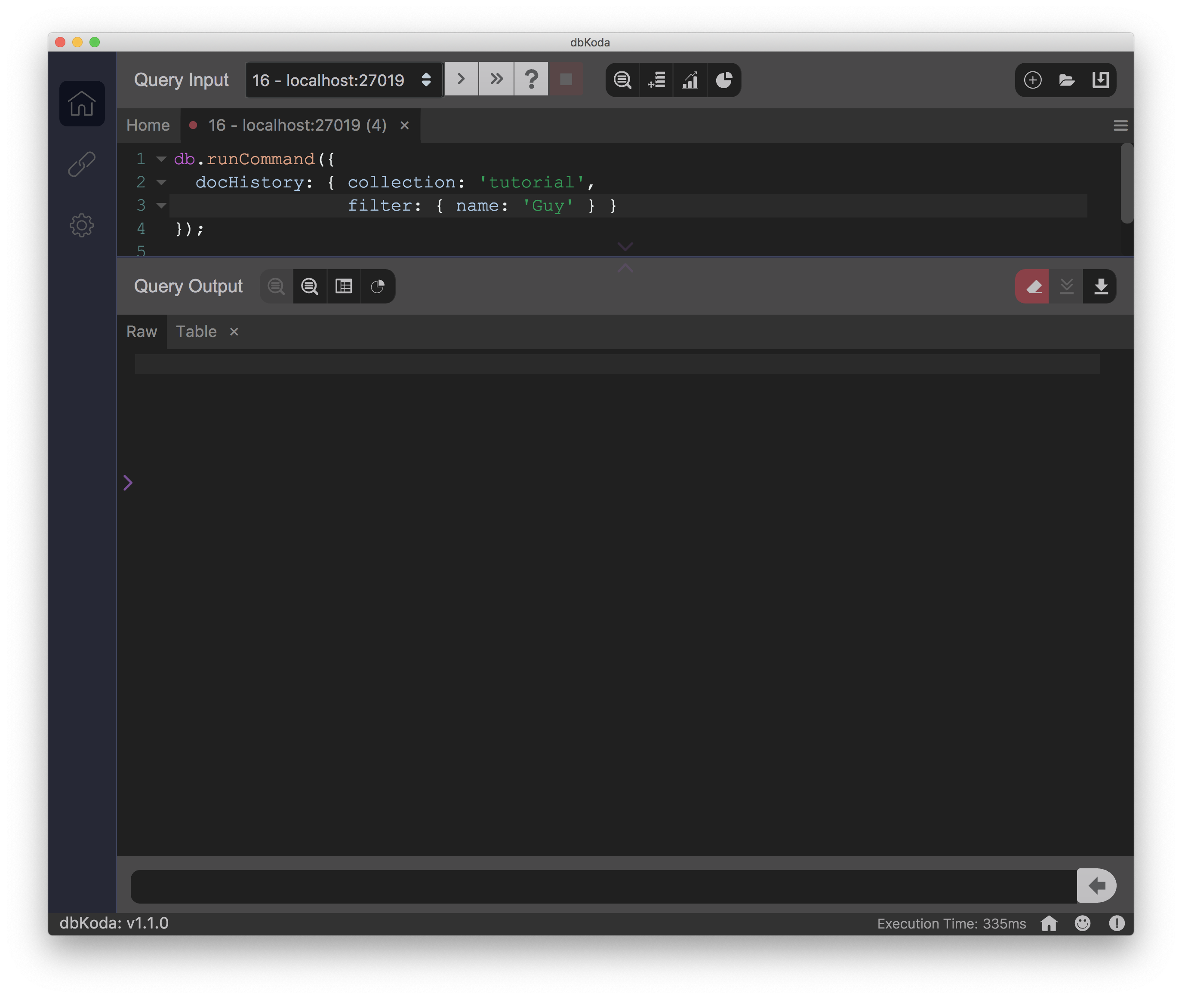
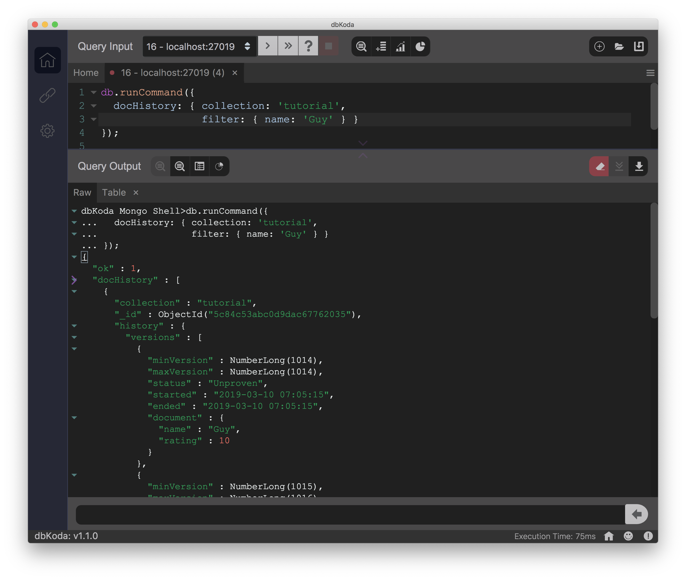
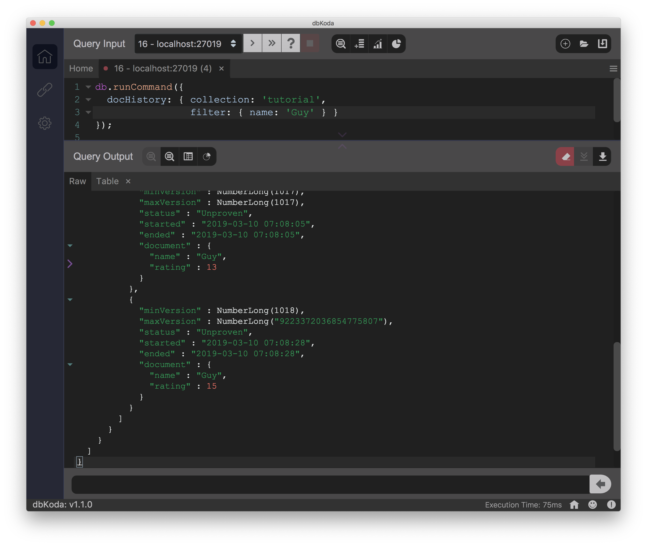
Document History
docHistory command allows you to see the complete history of a particular document

Slide 25
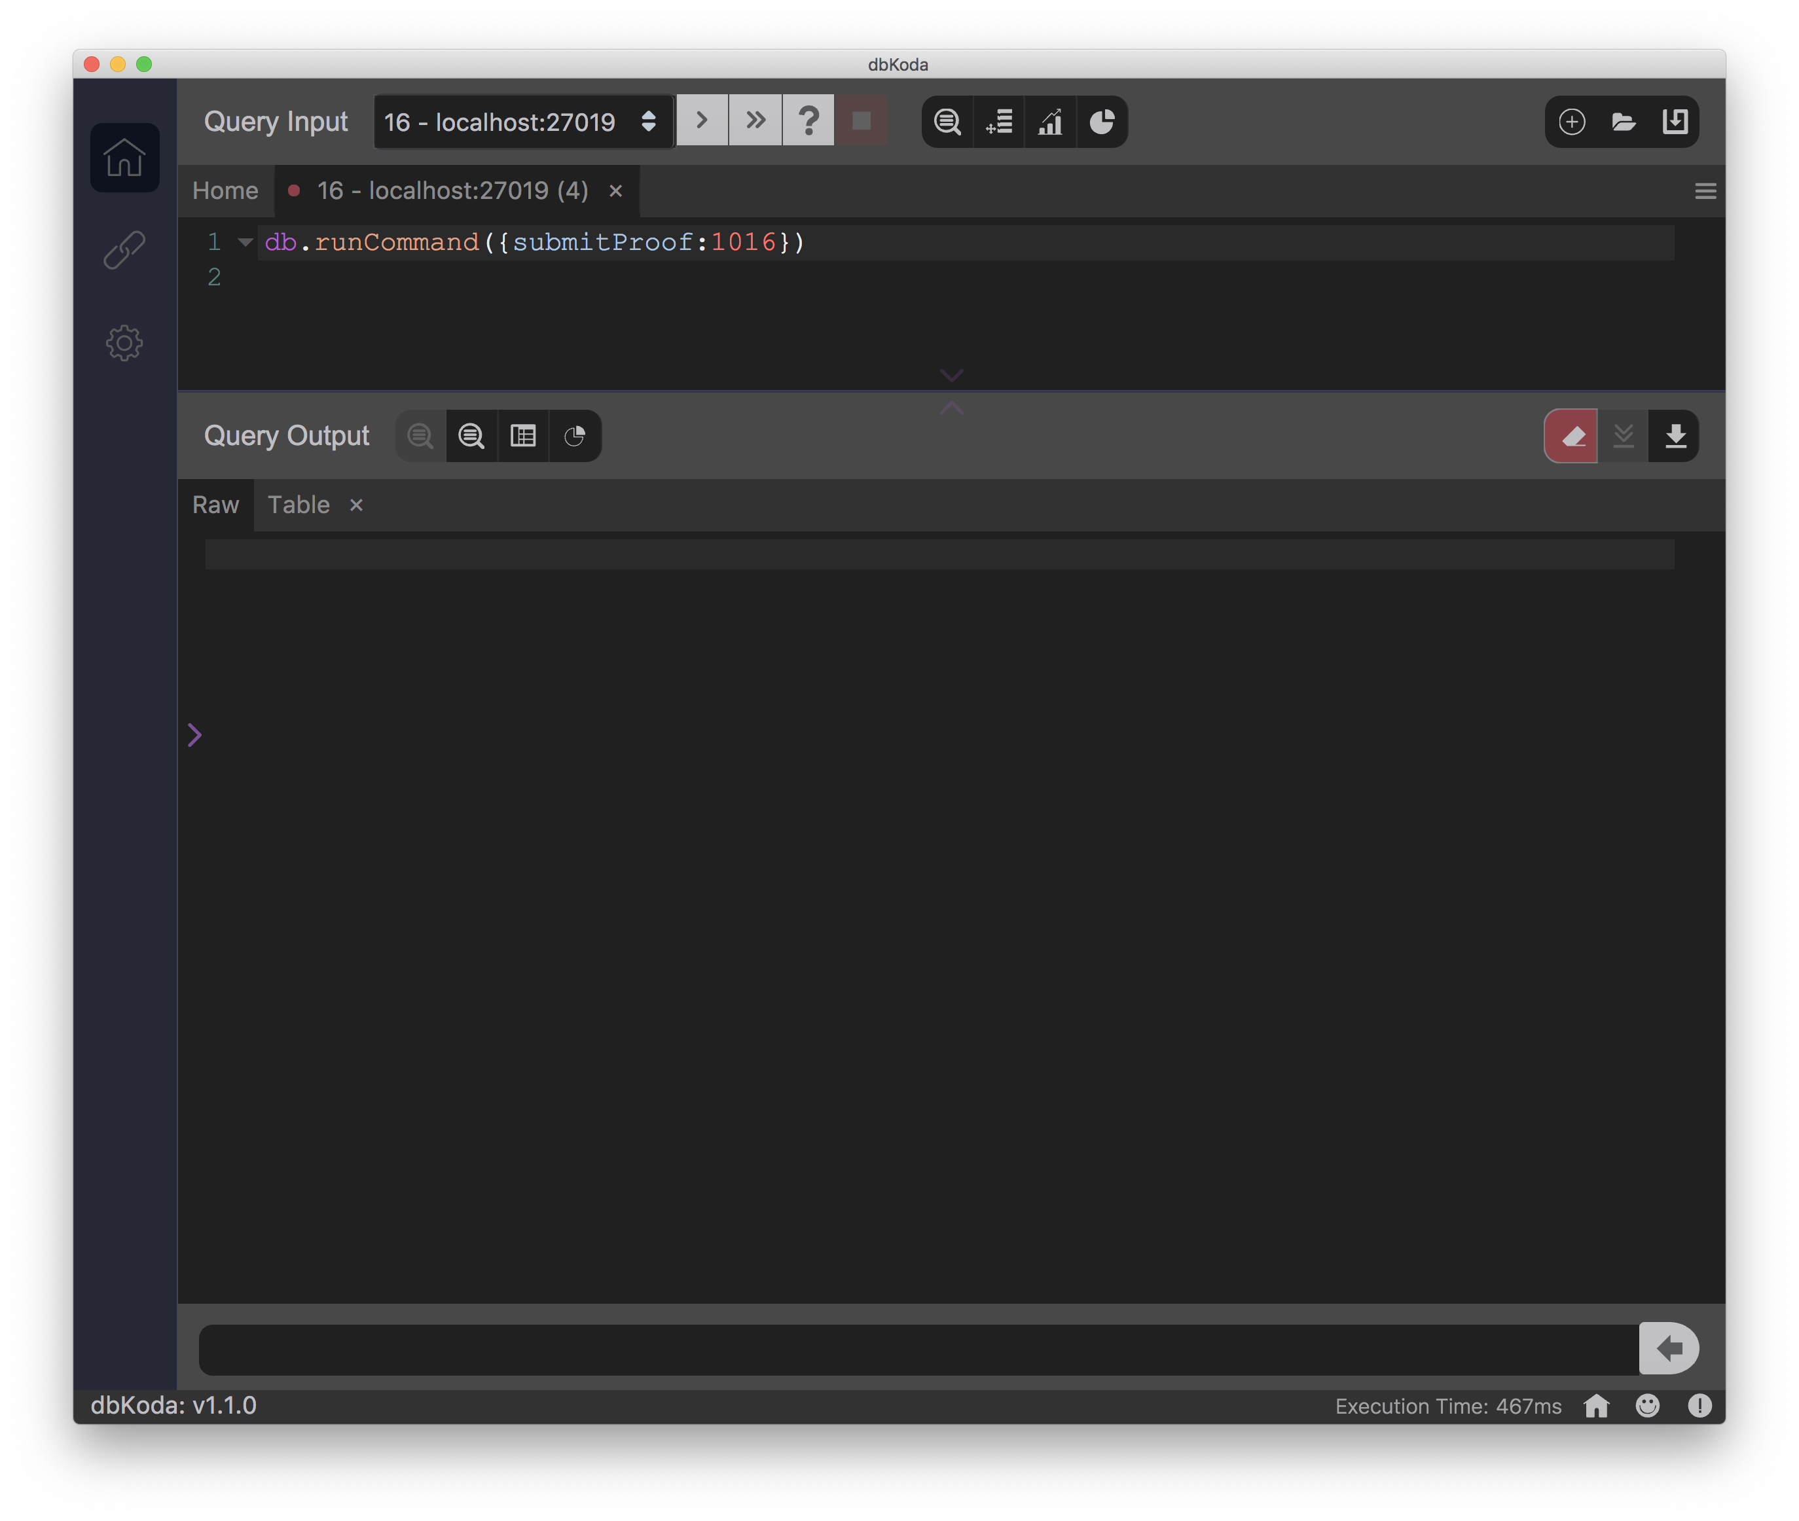
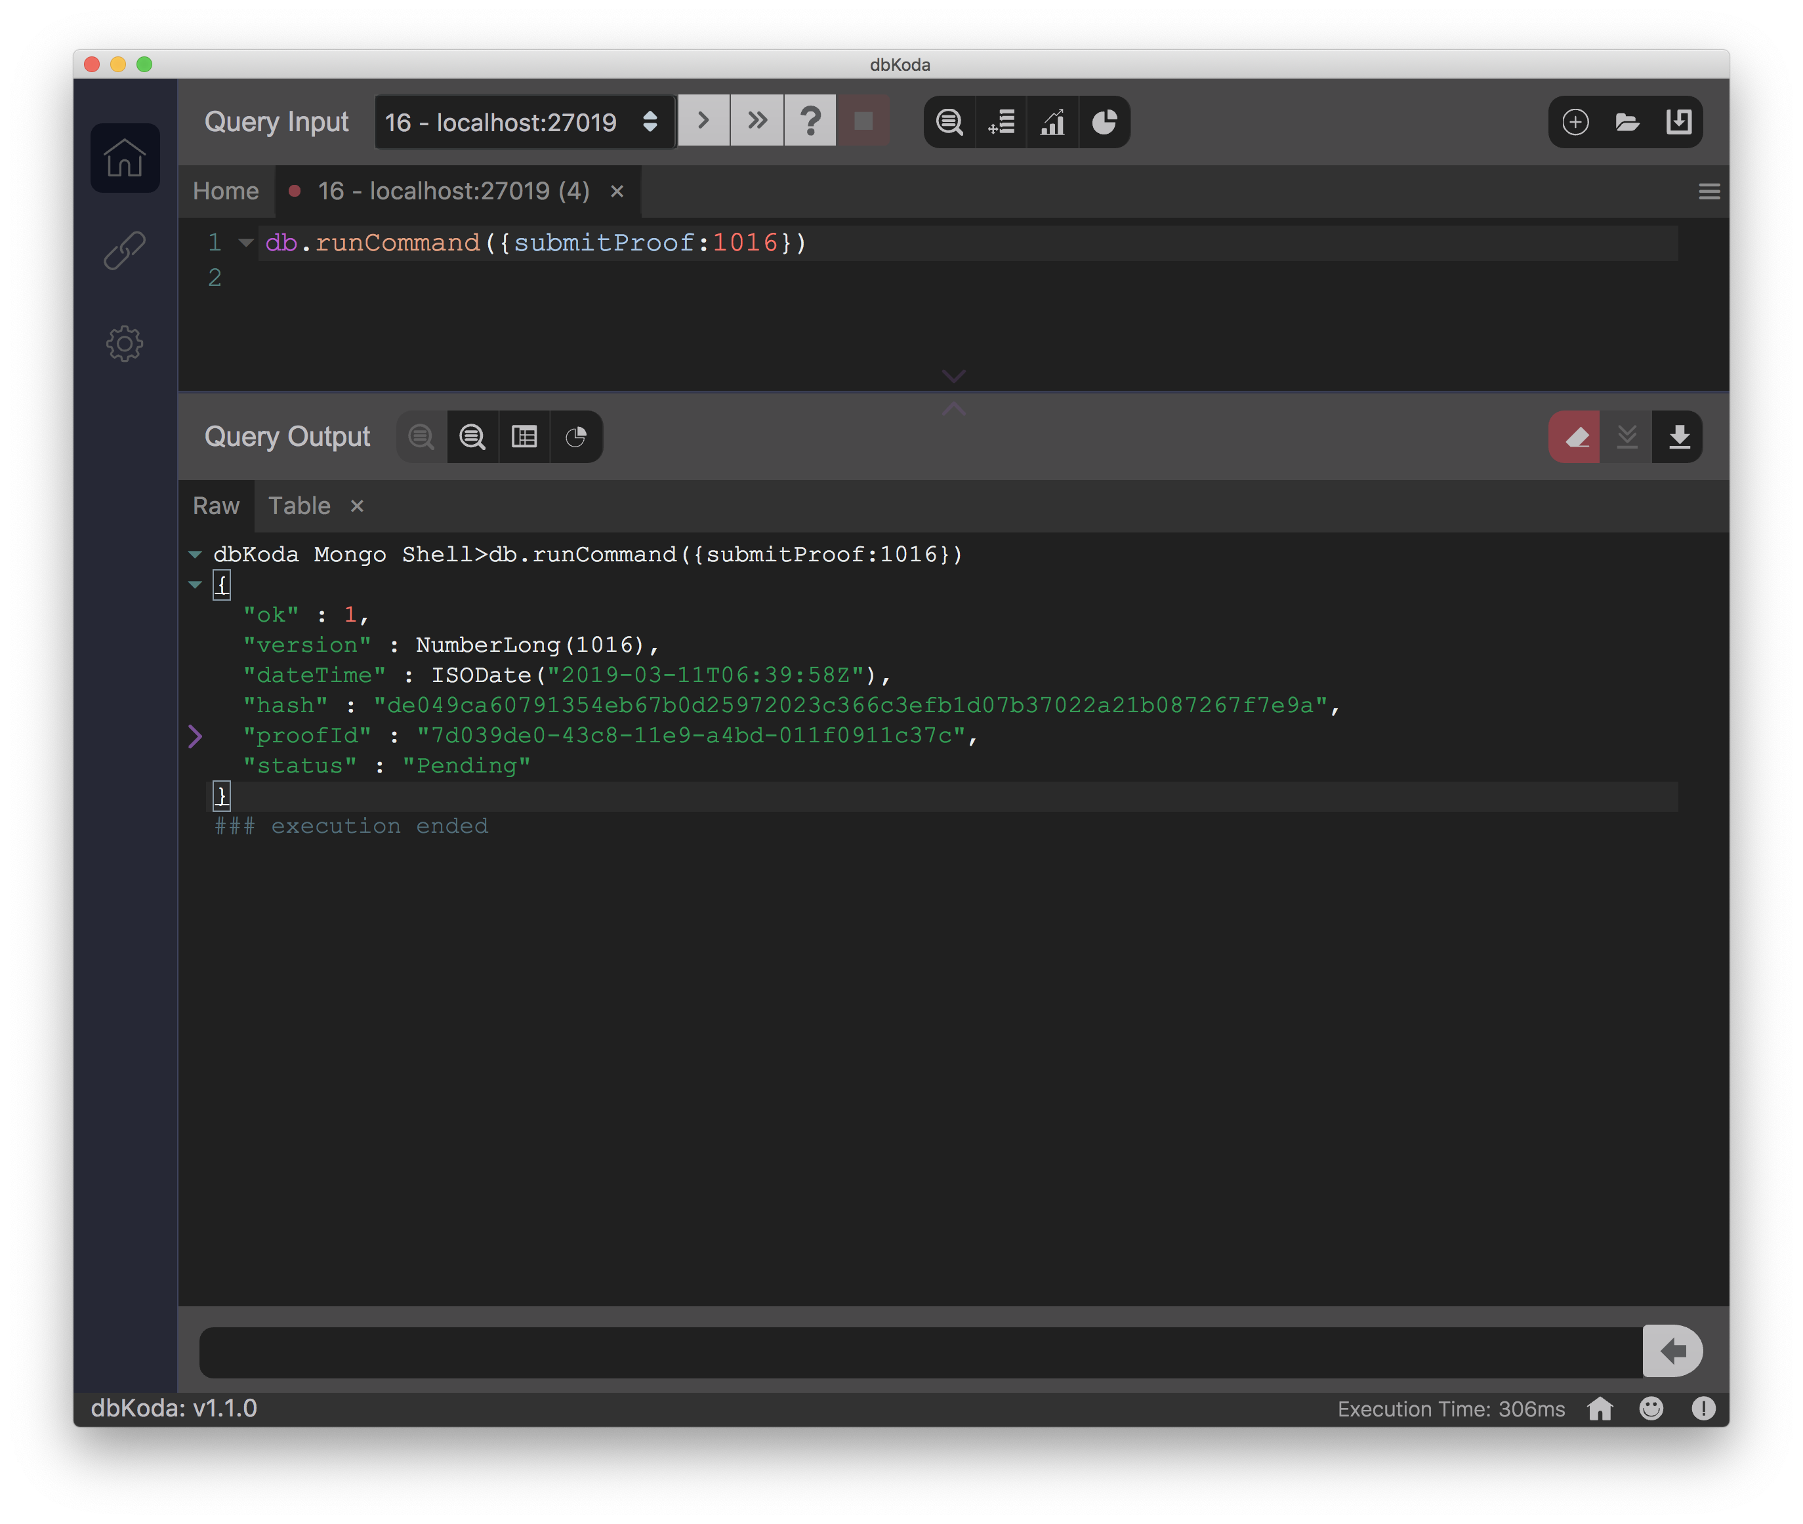
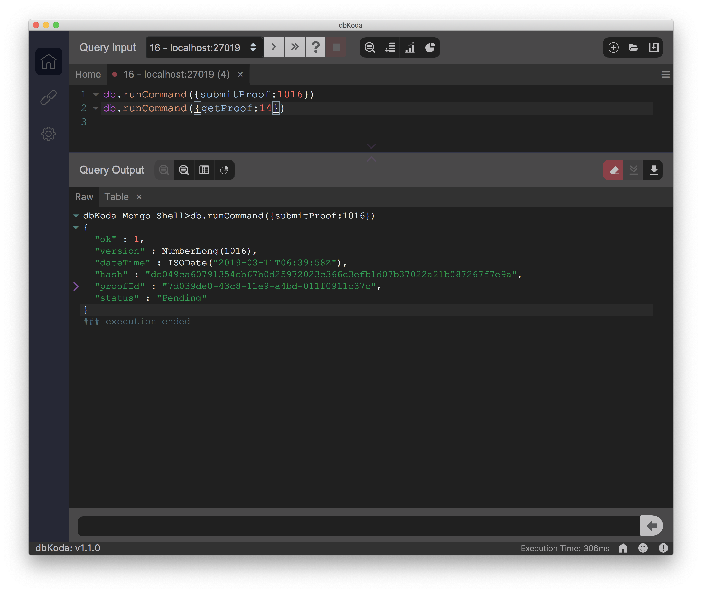
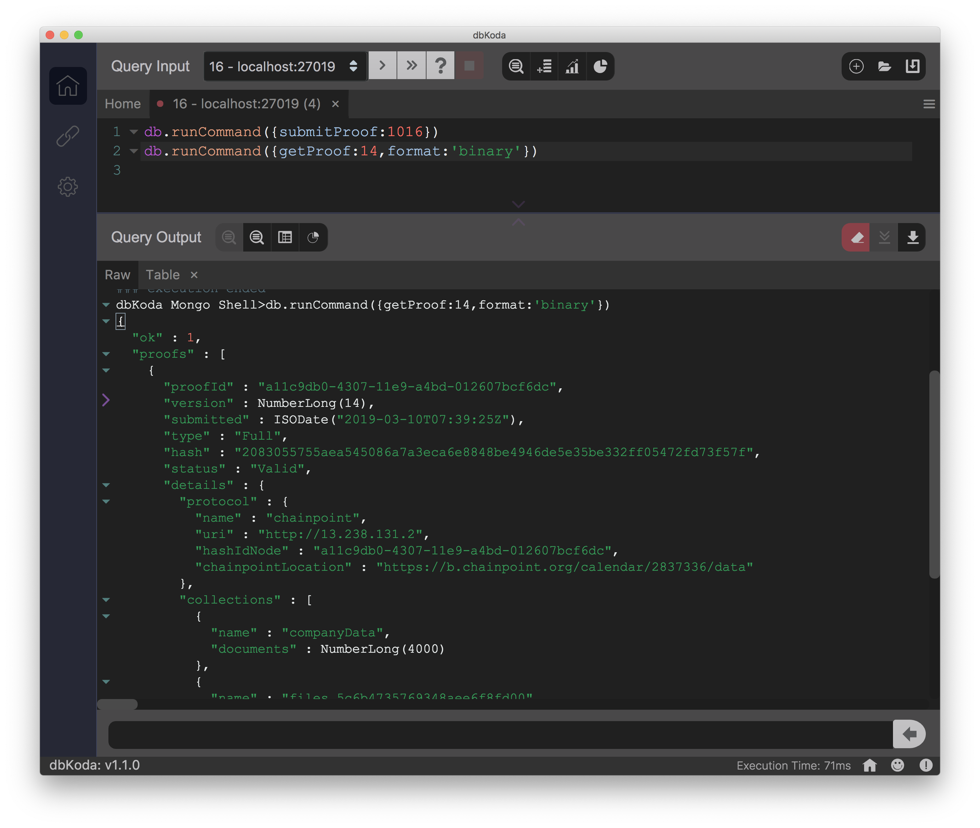
Proofs
submitProof creates a blockchain proof for a particular database version
getProof retrieves a Chainpoint compatible blockchain proof for that database version

Slide 26
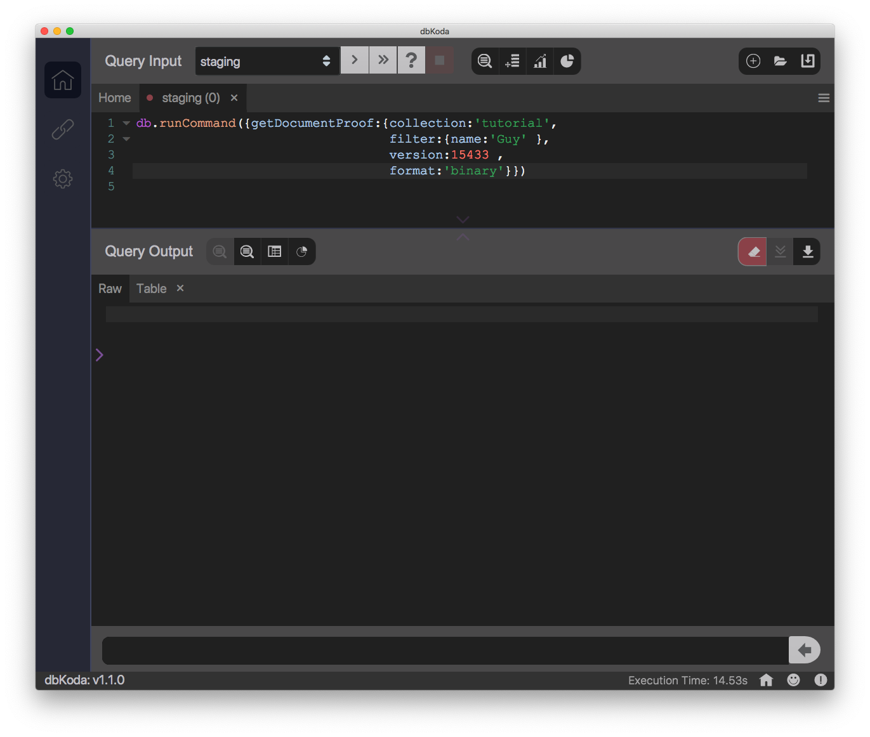
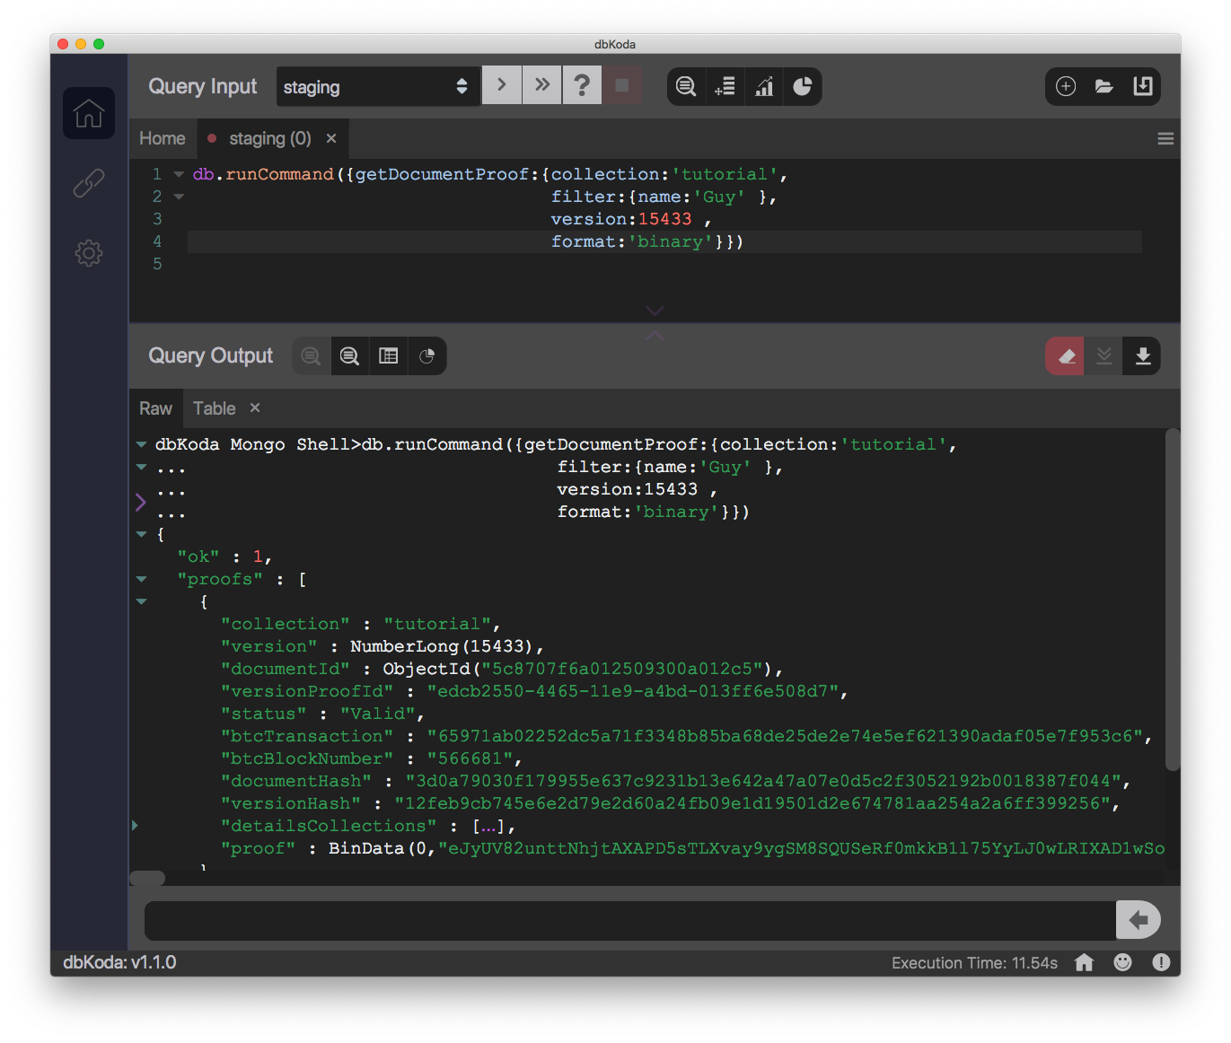
Document Proofs
getDocumentProof returns a Chainpoint proof for an individual document

Slide 27
ProvenDocs – A ProvenDB application

Slide 28
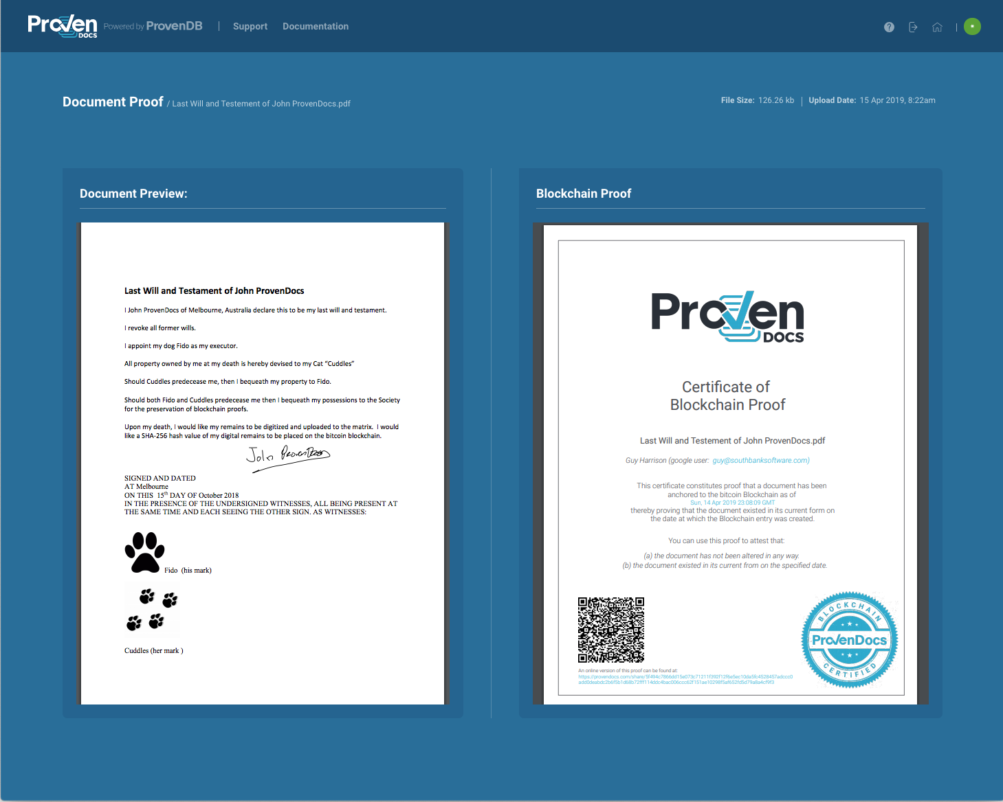
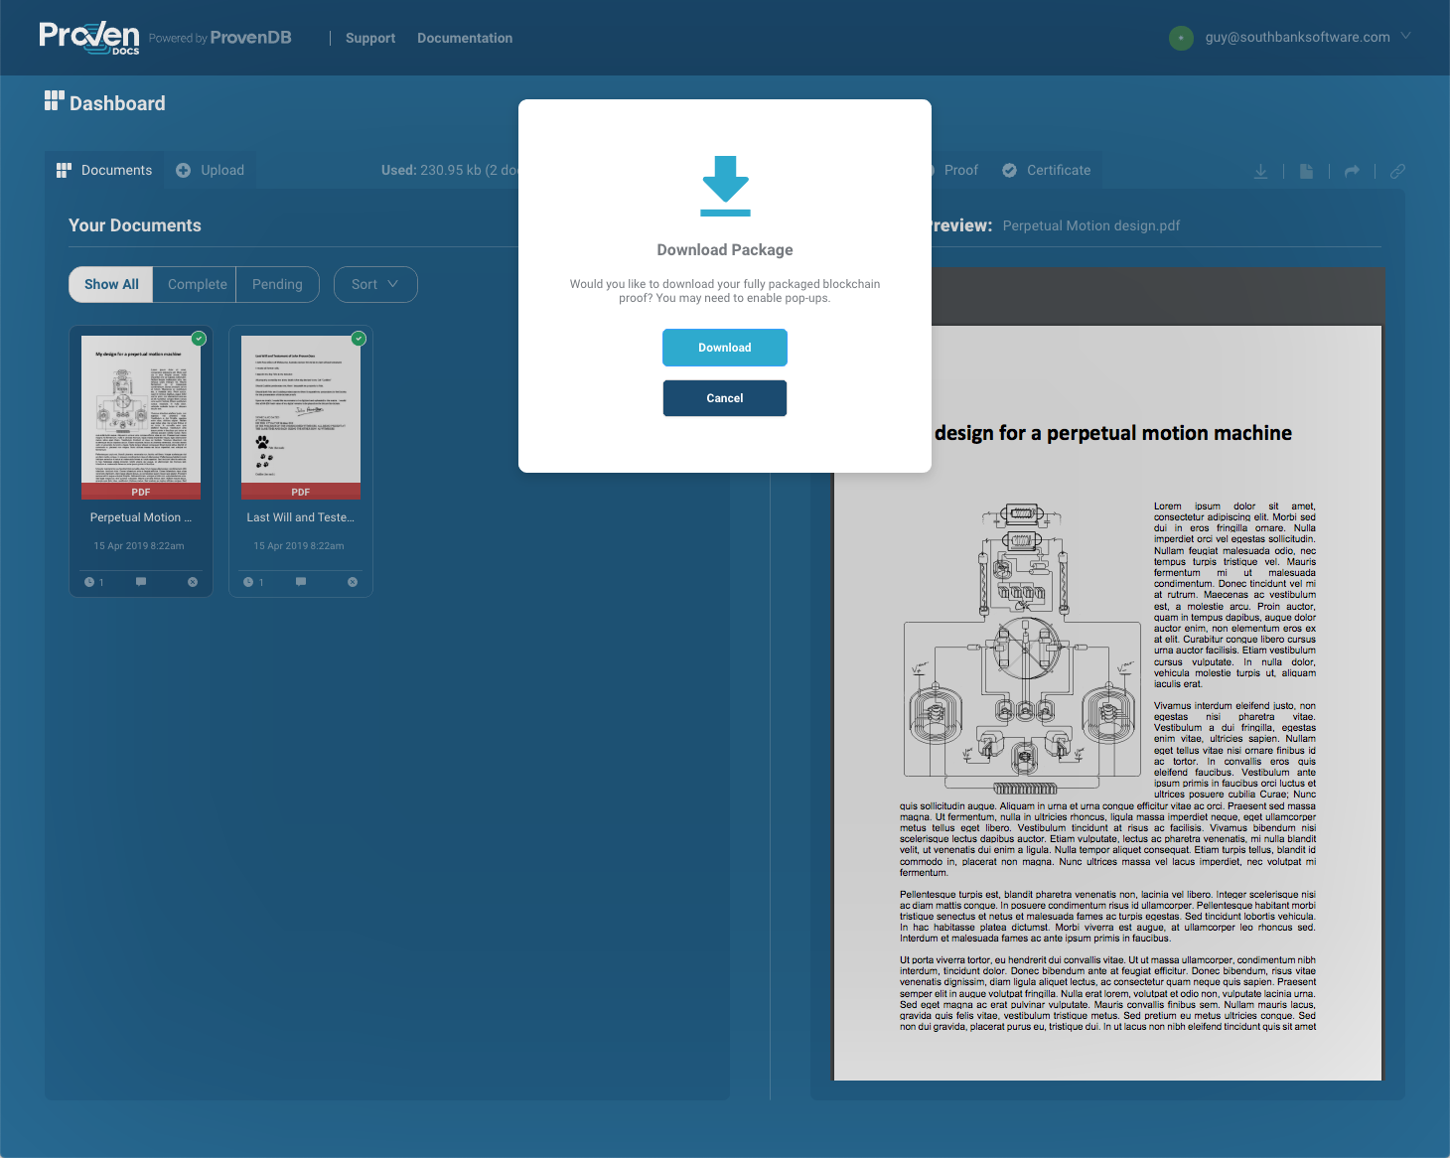
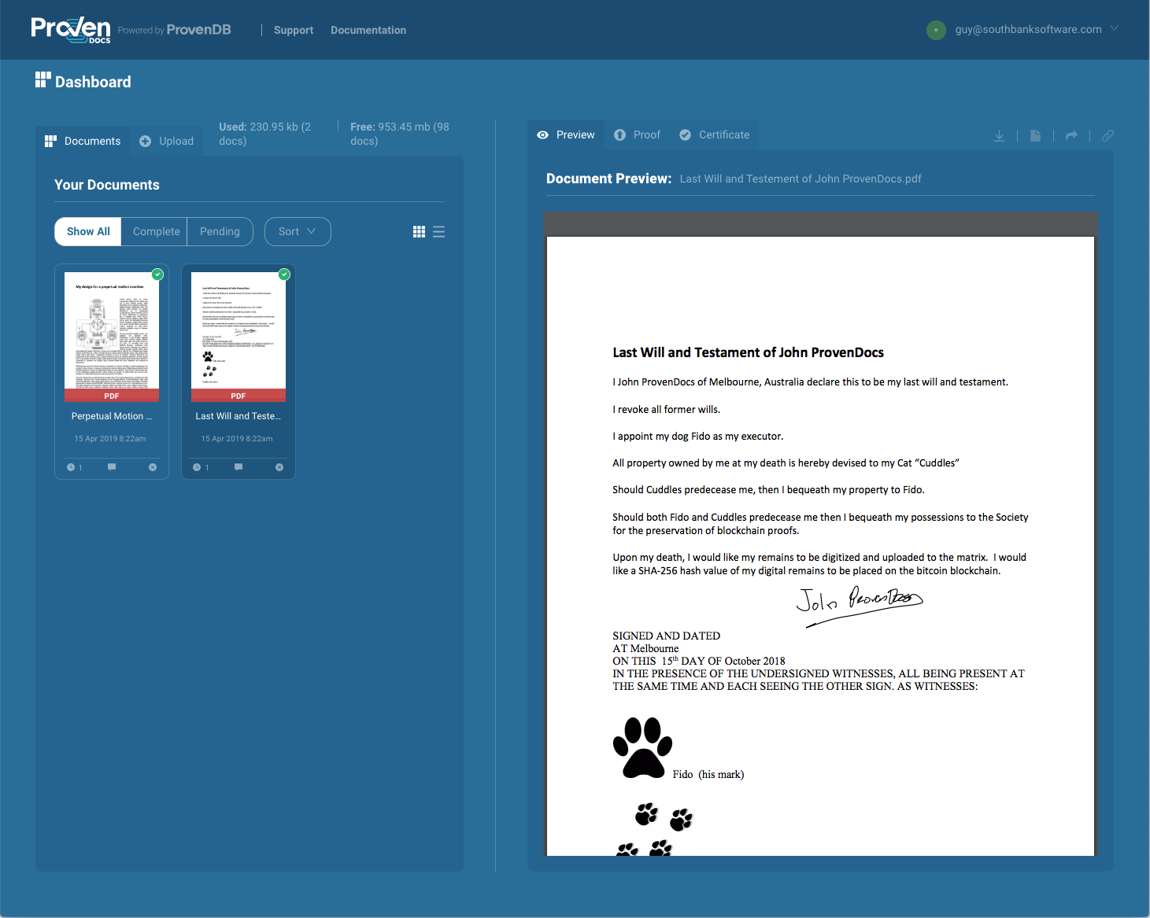
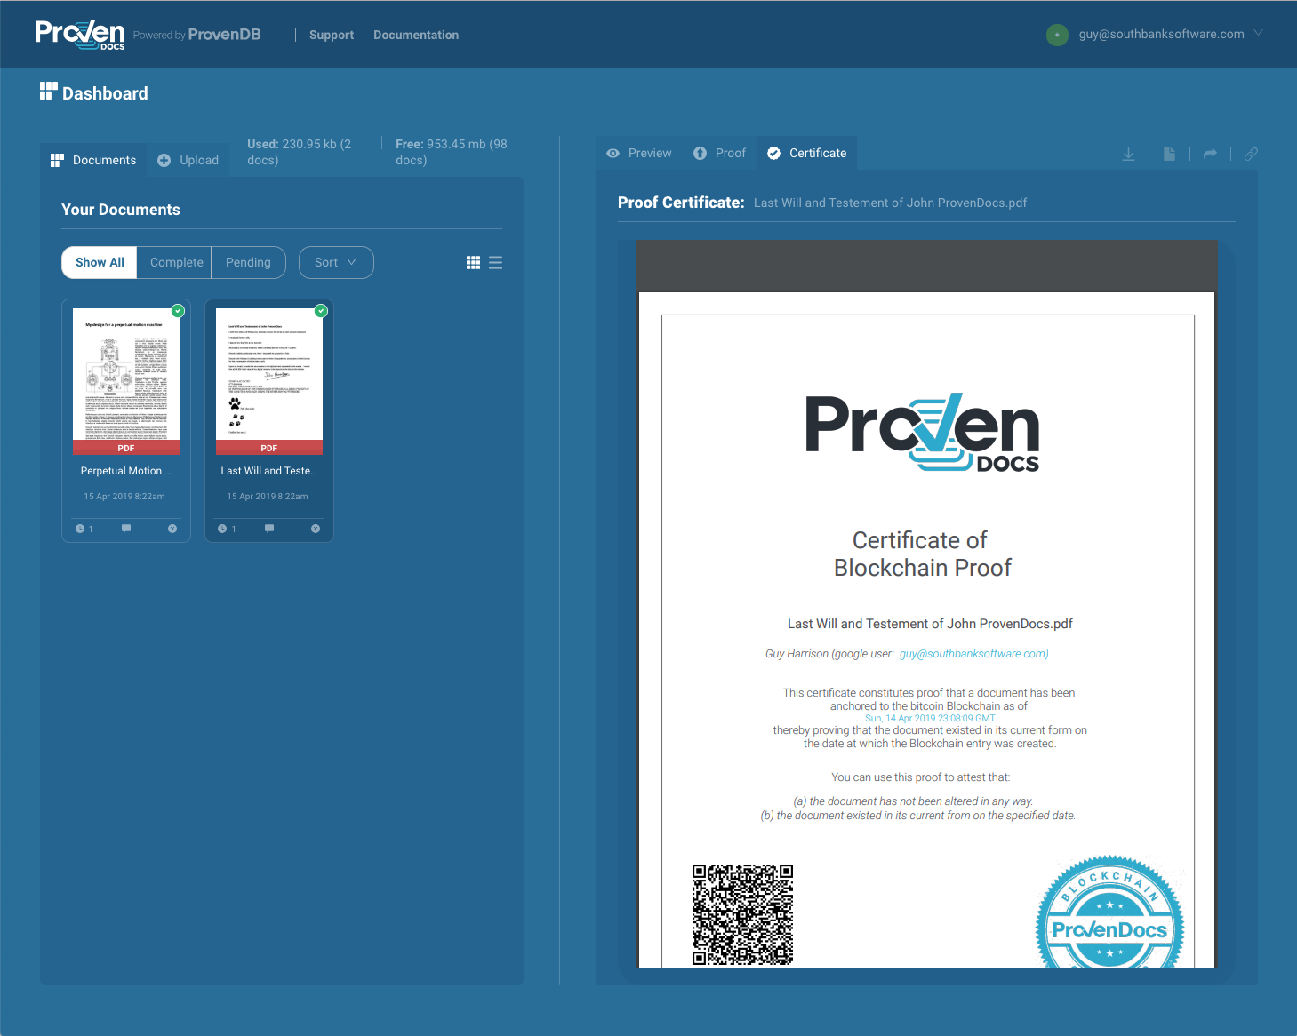
ProvenDocs.com
Upload or email your documents to provendocs.com.
Blockchain proofs are automatically created
Download your document proofs or share them with other ProvenDocs users.

Slide 29

Thank you!
Any questions?
Guy Harrison
CTO ProvenDB
Sign up for a early adopter account at ProvenDB.com
(+61) 418 533 988
guy@provendb.com
/guyharrison
/guyharrison

